Slide 1
“Supplementary tools in receptor modeling based source apportionment: trajectory statistical methods (TSM)”
Dr PEDRO SALVADOR
Department of Environment - CIEMAT, Madrid, Spain
Regional Training Course on Source Identification and Apportionment of Air Particulate Matter (APM), Sacavem, Portugal, 2 – 6 June 2014

Slide 2
STRUCTURE OF THE PRESENTATION
Brief introduction on the sources of APM
Description of the main TSM
Results obtained at different study areas
Conclusion: Profits and Limitations of TSM

Slide 3
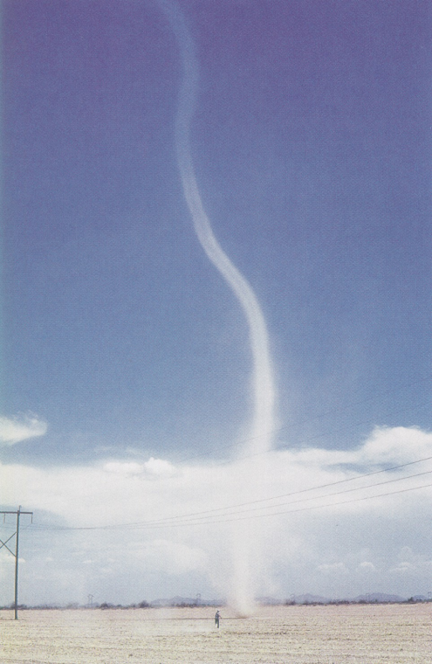
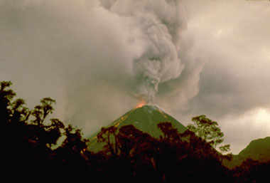
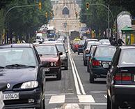
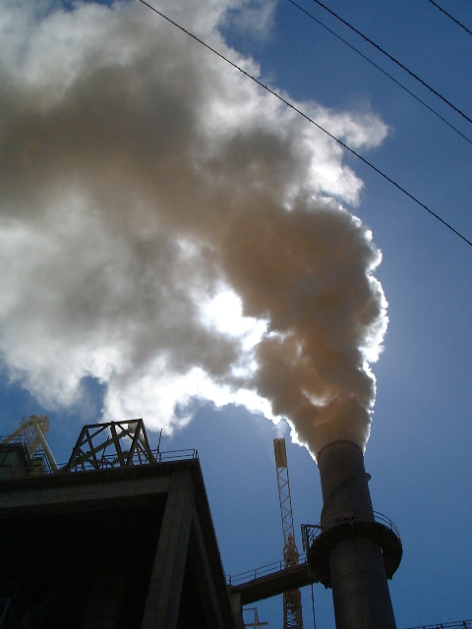
INTRODUCTION
ATMOSPHERIC PARTICULATE MATTER (APM)
HETEROGENEOUS GROUP OF COMPONENTS COMING FROM SEVERAL SOURCES
MINERAL DUST
SEA SPRAY
VOLCANOS
BIOLOGIC PARTICLES
NATURAL
PRIMARY APM
ROAD TRAFFIC
INDUSTRIAL ACTIVITIES
AGRICULTURE ACTIVITIES
ANTHROPOGENIC
NATURAL
VOLCANIC EMISSIONS
OCEANS
ACTIVIDAD BACTERIANA TERRESTRE
INORGANIC
Sulfates from SO₂
Nitrates from NO_{x}
ANTHROPOGENIC
ROAD TRAFFIC
INDUSTRIAL ACTIVITIES
FOSSIL FUELS COMBUSTION
SECONDARY APM
ORGANIC
NATURALES
BIOGENIC EMISSIONS
From VOC_{S}
ANTROPOGÉNICAS
TRAFFIC
FUEL EVAPORATION
COMBUSTION PROCESSES

Slide 4
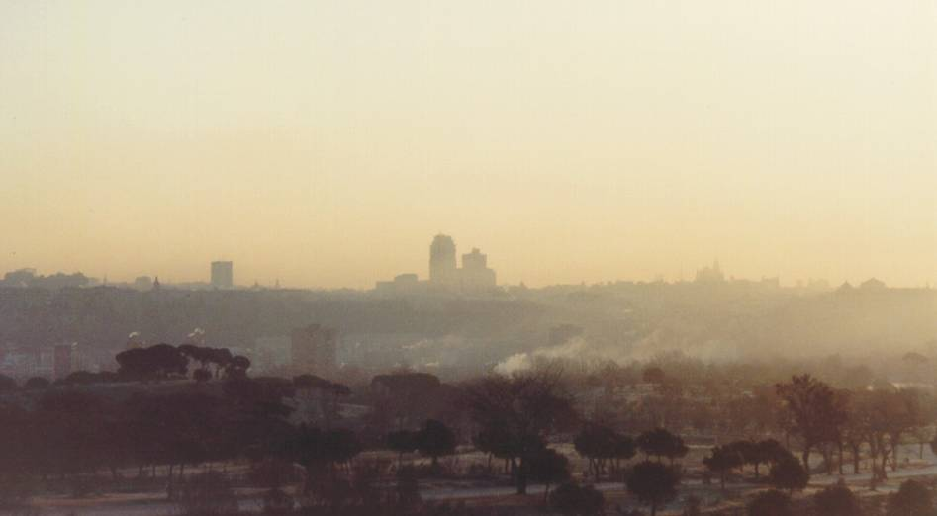
INTRODUCTION
ORIGIN OF THE APM
LOCAL
SOURCES
REMOTE
SOURCES
PRIMARY
APM
NATURAL
ANTHROPOGENIC
NATURAL
ANTHROPOGENIC
APM
LONG-RANGE
AND REGIONAL
TRANSPORT
PROCESSES
LOCAL EMISSIONS
SECONDARY
APM
NATURAL
ANTHROPOGENIC
NATURAL
ANTHROPOGENIC

Slide 5
INTRODUCTION
EFFECTS OF APM ON HUMAN HEALTH
There is a causal relationship between the exposition to APM and the occurrence of adverse effects on human health (WHO, Health risks of particulate matter from long-range transboundary air pollution, 2006)
Effects related to PM₁₀ and PM_{2.5}
Directive 1999/30/EC – Limit Values of PM₁₀
Directive 2008/50/EC – Objective Values of PM_{2.5}
PROBLEM
Episodes of long-range transport of APM from transboundary source areas, may lead to exceedances of Limit Values

Slide 6
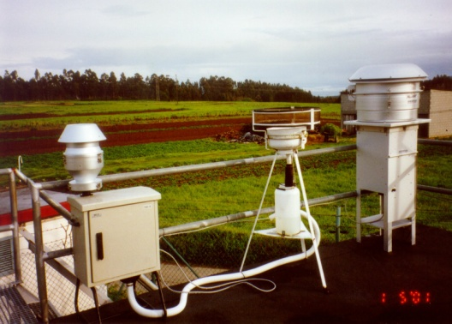
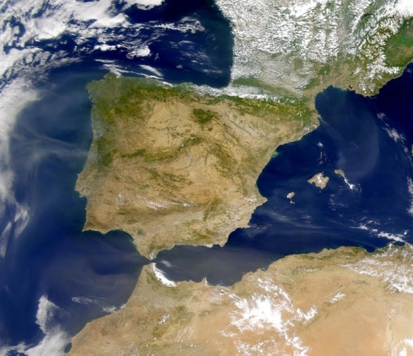
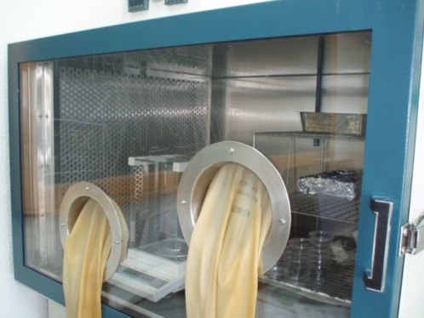
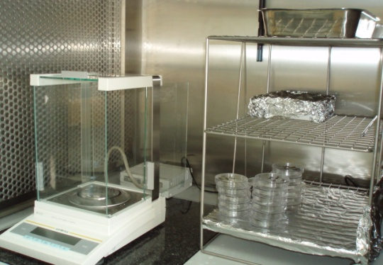
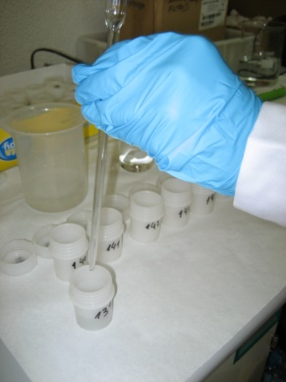
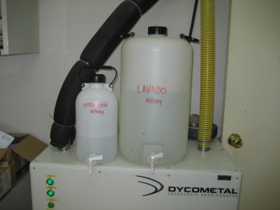
INTRODUCTION
Characterizing levels and chemical composition of APM
I – Chemical characterization
Regional background site
Obtention of samples of APM with filters and high-volume samplers
Gravimetric determination of the APM concentration
Chemical analysis of the samples (C, SO₄²⁻, NH₄⁺, NO₃⁻, Fe, Ca, Zn, V…)

Slide 7
INTRODUCTION
Characterizing levels and chemical composition of APM
I – Chemical characterization
Finally, a data file of APM components concentrations are obtained for each sampling period (24 hours,…)

Slide 8
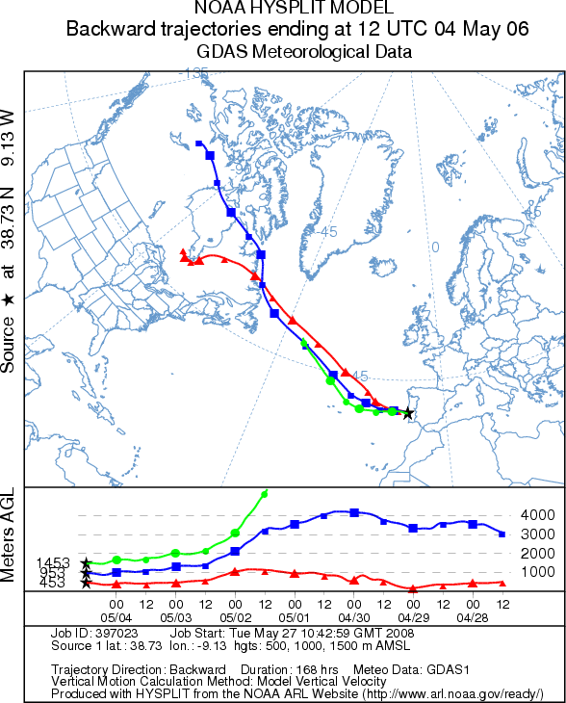
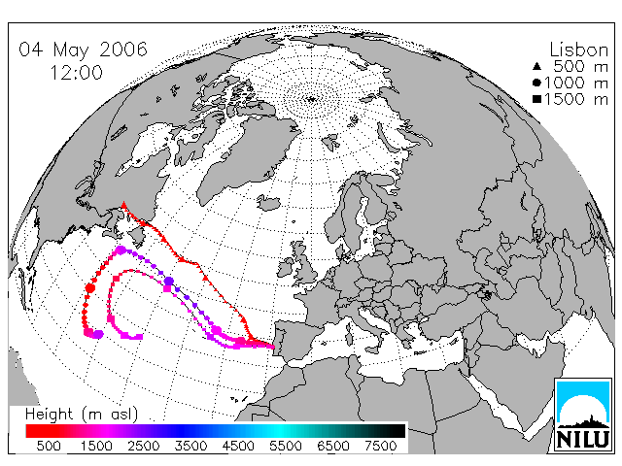
INTRODUCTION
Characterizing levels and chemical composition of APM
II – Meteorological information
Computing air mass back-trajectories
HYSPLIT model (Draxler et al.)
FLEXTRA model (Stohl et al.)
Each execution of the model generates a data file with the geographical coordinates (longitude, latitude and altitude) of the trajectory Time Steps

Slide 9
INTRODUCTION
Characterizing levels and chemical composition of APM
II – Meteorological information
HYSPLIT model
FLEXTRA model
1 BACKWARD OMEGA
8 5 1 12 38.730 -9.130 500.0
1 PRESSURE
1 1 8 5 1 12 0 0 0.0 38.730 -9.130 500.0 950.1
1 1 8 5 1 11 0 1 -1.0 38.770 -9.152 516.0 948.4
1 1 8 5 1 10 0 2 -2.0 38.826 -9.186 533.3 946.5
1 1 8 5 1 9 0 3 -3.0 38.895 -9.232 552.4 944.5
1 1 8 5 1 8 0 2 -4.0 38.972 -9.289 570.1 941.9
1 1 8 5 1 7 0 1 -5.0 39.054 -9.357 582.3 940.4
1 1 8 5 1 6 0 0 -6.0 39.141 -9.436 589.3 939.6
1 1 8 5 1 5 0 1 -7.0 39.235 -9.528 591.4 939.6
1 1 8 5 1 4 0 2 -8.0 39.336 -9.634 588.9 940.3
1 1 8 5 1 3 0 3 -9.0 39.444 -9.753 583.1 941.5
1 1 8 5 1 2 0 2 -10.0 39.553 -9.883 580.4 943.8
1 1 8 5 1 1 0 1 -11.0 39.657 -10.023 586.5 944.4
1 1 8 5 1 0 0 0 -12.0 39.757 -10.168 601.7 943.6
1 1 8 4 30 23 0 1 -13.0 39.859 -10.303 623.9 941.2
1 1 8 4 30 22 0 2 -14.0 39.968 -10.415 649.4 938.5
1 1 8 4 30 21 0 3 -15.0 40.081 -10.507 676.0 935.0
1 1 8 4 30 20 0 2 -16.0 40.198 -10.607 699.1 931.7
1 1 8 4 30 19 0 1 -17.0 40.317 -10.741 716.7 929.6
1 1 8 4 30 18 0 0 -18.0 40.437 -10.908 731.5 928.0
1 1 8 4 30 17 0 1 -19.0 40.550 -11.100 748.6 926.3
1 1 8 4 30 16 0 2 -20.0 40.646 -11.309 769.5 923.4
1 1 8 4 30 15 0 3 -21.0 40.729 -11.532 791.5 920.4
1 1 8 4 30 14 0 2 -22.0 40.815 -11.767 811.5 917.7
1 1 8 4 30 13 0 1 -23.0 40.917 -12.013 829.7 915.5
1 1 8 4 30 12 0 0 -24.0 41.032 -12.269 851.5 914.2
1 1 8 4 30 11 0 1 -25.0 41.151 -12.532 876.3 911.6
1 1 8 4 30 10 0 2 -26.0 41.263 -12.799 900.4 908.7
1 1 8 4 30 9 0 3 -27.0 41.372 -13.064 921.8 905.9
1 1 8 4 30 8 0 2 -28.0 41.492 -13.321 938.7 903.4
1 1 8 4 30 7 0 1 -29.0 41.634 -13.572 951.9 901.9
1 1 8 4 30 6 0 0 -30.0 41.798 -13.817 964.7 900.9
1 1 8 4 30 5 0 1 -31.0 41.982 -14.062 979.8 899.8
1 1 8 4 30 4 0 2 -32.0 42.178 -14.314 996.6 897.2
1 1 8 4 30 3 0 3 -33.0 42.381 -14.573 1014.7 894.6
1 1 8 4 30 2 0 2 -34.0 42.594 -14.836 1034.3 892.3
1 1 8 4 30 1 0 1 -35.0 42.824 -15.098 1057.0 890.2
1 1 8 4 30 0 0 0 -36.0 43.073 -15.349 1084.4 888.5
1 1 8 4 29 23 0 1 -37.0 43.349 -15.597 1113.9 885.5
1 1 8 4 29 22 0 2 -38.0 43.662 -15.852 1142.2 882.6
1 1 8 4 29 21 0 3 -39.0 44.017 -16.106 1170.1 879.5
1 1 8 4 29 20 0 2 -40.0 44.408 -16.372 1198.3 876.0
1 1 8 4 29 19 0 1 -41.0 44.826 -16.651 1229.4 872.6
1 1 8 4 29 18 0 0 -42.0 45.265 -16.926 1264.6 868.3
1 1 8 4 29 17 0 1 -43.0 45.728 -17.197 1298.2 863.7
1 1 8 4 29 16 0 2 -44.0 46.225 -17.456 1332.2 860.1
1 1 8 4 29 15 0 3 -45.0 46.755 -17.675 1380.1 855.3
1 1 8 4 29 14 0 2 -46.0 47.314 -17.872 1441.2 847.3
1 1 8 4 29 13 0 1 -47.0 47.895 -18.053 1509.0 839.9
DATE: 19951231 TIME: 180000 STOP INDEX: 1 # OF POINTS: 57
SECS LONGIT LATIT ETA PRESS Z Z-ORO PV THETA
0 -9.1300 38.7300 0.8950 892.3 1000.0 923.4 0.356 293.0
-10800 -10.4856 37.6704 0.9235 928.6 671.3 669.1 0.280 291.9
-21600 -11.9921 36.8294 0.9358 944.3 559.9 560.4 0.218 291.4
-32400 -13.4789 36.0457 0.9411 948.8 514.6 513.9 0.182 291.8
-43200 -14.8989 35.3208 0.9454 952.7 475.3 475.4 0.177 291.9
-54000 -16.4356 34.7130 0.9429 952.1 499.5 498.3 0.191 292.0
-64800 -18.0532 34.2920 0.9406 950.6 522.0 518.6 0.169 291.7
-75600 -19.6724 33.9720 0.9430 952.3 497.6 497.0 0.185 292.1
-86400 -21.3852 33.6567 0.9469 955.9 463.1 463.4 0.123 292.4
-97200 -23.2542 33.2428 0.9500 959.3 436.6 436.5 0.122 292.6
-108000 -25.1629 32.7111 0.9490 959.8 446.0 446.1 0.093 292.6
-118800 -27.0620 32.3153 0.9459 955.3 473.4 473.2 0.083 292.6
-129600 -29.0467 32.0841 0.9464 956.0 469.1 469.1 0.067 292.7
-140400 -31.0959 31.8226 0.9450 955.1 482.2 482.1 0.079 292.8
-151200 -33.1157 31.5718 0.9428 954.5 502.6 502.5 0.053 292.8
-162000 -35.0902 31.3746 0.9421 952.7 507.0 507.4 0.016 292.6
-172800 -36.9832 31.1284 0.9397 950.0 529.2 529.4 0.007 292.8
-183600 -38.9525 31.0145 0.9351 947.8 571.0 571.6 0.006 292.8
-194400 -41.0687 31.0566 0.9307 942.2 611.1 610.8 0.025 292.7
-205200 -43.3662 31.1032 0.9174 927.9 731.9 731.5 0.043 292.5
-216000 -45.7492 31.1085 0.9006 910.7 885.4 885.6 0.051 292.6
-226800 -48.1283 31.1549 0.8893 900.4 989.6 990.1 0.118 292.7
-237600 -50.4930 31.2272 0.8781 888.8 1094.5 1094.1 0.138 292.4
-248400 -52.8538 31.3259 0.8682 877.9 1184.3 1184.4 0.142 292.0
-259200 -55.3059 31.4186 0.8554 864.4 1302.9 1302.6 0.170 292.0
-270000 -57.8166 31.4696 0.8339 844.8 1508.4 1508.5 0.179 291.8
-280800 -60.4712 31.5584 0.8046 814.1 1791.9 1791.7 0.182 291.7
-291600 -63.2402 31.5922 0.7830 792.5 2005.5 2005.8 0.172 291.9
-302400 -65.8393 31.4872 0.7851 793.7 1982.3 1982.3 0.166 291.9
-313200 -68.1784 31.3324 0.7915 801.8 1917.5 1917.7 0.191 291.2
-324000 -70.2369 31.3016 0.7827 792.6 2004.1 2003.7 0.202 290.8
-334800 -72.2656 31.4000 0.7735 782.2 2095.7 2095.0 0.337 291.8
-345600 -74.3624 31.5552 0.7725 781.8 2101.9 2101.9 0.389 292.2
-356400 -76.6973 31.7885 0.7595 770.6 2233.5 2232.8 0.458 293.8
-367200 -79.0091 32.1619 0.7623 774.3 2193.5 2196.7 0.350 293.8
-378000 -81.0771 32.5045 0.7697 780.1 2136.5 2106.1 0.442 293.5
-388800 -82.8514 33.0440 0.7868 789.4 2045.2 1921.5 0.441 293.8
-399600 -84.6605 33.9856 0.8073 794.4 1996.1 1692.1 0.464 293.1
-410400 -86.6398 35.0263 0.8001 791.2 2026.4 1770.1 0.430 293.4
-421200 -88.6025 36.0336 0.7825 784.4 2097.5 1958.5 0.493 293.5
-432000 -90.4443 37.1575 0.7920 791.0 2041.4 1861.6 0.493 293.4
-442800 -92.2832 38.4627 0.7952 786.9 2085.4 1822.8 0.363 293.6
-453600 -94.1469 39.7358 0.7961 785.9 2101.2 1818.9 0.312 294.2
-464400 -95.9461 40.8854 0.8019 783.5 2133.3 1756.8 0.335 294.6
-475200 -97.4945 42.0046 0.8127 783.5 2141.9 1644.5 0.338 294.6
-486000 -98.8858 43.3309 0.8125 778.2 2201.6 1643.5 0.244 295.3
-496800 -100.3474 44.7868 0.8244 786.1 2128.1 1529.6 0.212 295.6
-507600 -102.0059 46.0847 0.8459 793.1 2038.7 1315.3 0.253 296.7
-518400 -103.7007 47.1965 0.8473 792.6 2056.9 1298.2 0.232 297.1

Slide 10
OBJECTIVES
OBJECTIVES
Analizing simultaneously levels and chemical composition of APM and air mass back-trajectories
Discrimination of the origin of the air mass by sectors
Air masses origin
Based on visual inspection -> very subjective methodology
Rough estimation of the incidence of the origin of the air masses on the APM levels
Tedious task when working with a high number of back-trajectories
Mean PM10 levels (µg/m³)

Slide 11
OBJECTIVES
TRAJECTORY STATISTICAL METHODS (TSM)
Cluster Analysis (Dorling et al., 1992)
Residence Time Analysis – PSCF (Asbaugh et al., 1985)
Concentration Fields (Seibert et al., 1994; Stohl, 1996)
PROFITS
Characteryzing synoptic meteorological situations which give rise to low and high concentration levels of APM at a sampling site
Identifying potential source regions of APM which can be transported towards the sampling site

Slide 12
TSM – CLUSTER ANALYSIS - METHODOLOGY
Cluster Analysis - CA
CA is a statistical method used to examine a sample of objects and group them into sets (clusters), each comprissing objects of highest similarity
In this case, air masses trajectory time steps will be used as the clustering variables
Many clustering methods exists (Kalkstein et al., 1987; Gong and Richman, 1995)
Hierarchical Methods (agglomerative “there are as many clusters as there are objects” and divisive “all the objects begin in one cluster”):
        Ward’s minimum variance method
        The centroid method
        The average linkage method
Non-hierarchical Methods (choose a specified number of clusters k and then loops though all the objects in the data set):
        k-means method
        Nucleated agglomerative method
        Rotated principal component method
Each of the methods removes the subjectivity inherent in classification procedures to a certain extent, although leaving some decisions on the classifying subject

Slide 13
TSM – CLUSTER ANALYSIS - METHODOLOGY
Cluster Analysis - CA
Non-hierarchical k-means CA
It is assumed that non-hierarchical methods outperformed in general hierarchical methods (Gong and Richman, 1995)
This is the most popular non-hierarchical procedure
This is an iterative algorithm that partition the data by comparing each object to each of the k cluster centers by a dissimilarity measurement
Comprises 4 steps (Salvador et al., 2008, and references therein)

Slide 14
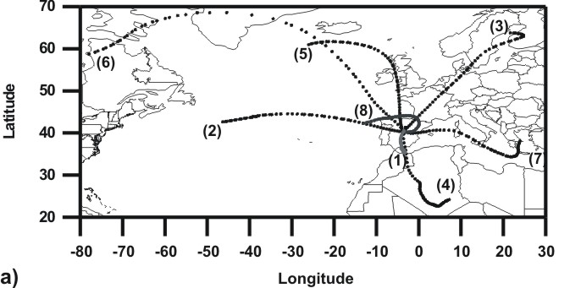
TSM – CLUSTER ANALYSIS - METHODOLOGY
Cluster Analysis - CA
STEP 1: Find an initial partitioning of the trajectories
An initial partition is defined: k back-trajectories covering most regions of the study area are selected as initial seeds or “cluster centers”
Subjectivity appears in the decision of how many clusters (k) should be retained for further analysis and in the selection procedure of the first k cluster centers (by a random choice from the data, by visual inspection, using the results of another clustering procedure…)
k-means CA is sensitive to the selection of the initial “cluster centers”

Slide 15
TSM – CLUSTER ANALYSIS - METHODOLOGY
Cluster Analysis
STEP 2: calculate the change in clusterion criterion that result from changes in membership and reassign trajectories
The clustering criterion is a measure of the distance between two trajectories
The method of calculation of the clustering criterion must be selected (city-block distance, Euclidean distance,..., Gong and Richman, 1995)
The distance from each trajectory j to each cluster-center k (d_{jk}) is calculated for every time step i along the trajectory (n time steps) and summed
ed_{ijk} is the Euclidean distance between time step i on trajectory j and time step i on cluster center k (x-longitude, y-latitude, z-altitude)
The trajectory is assigned to the cluster with the smallest total distance from its cluster center

Slide 16
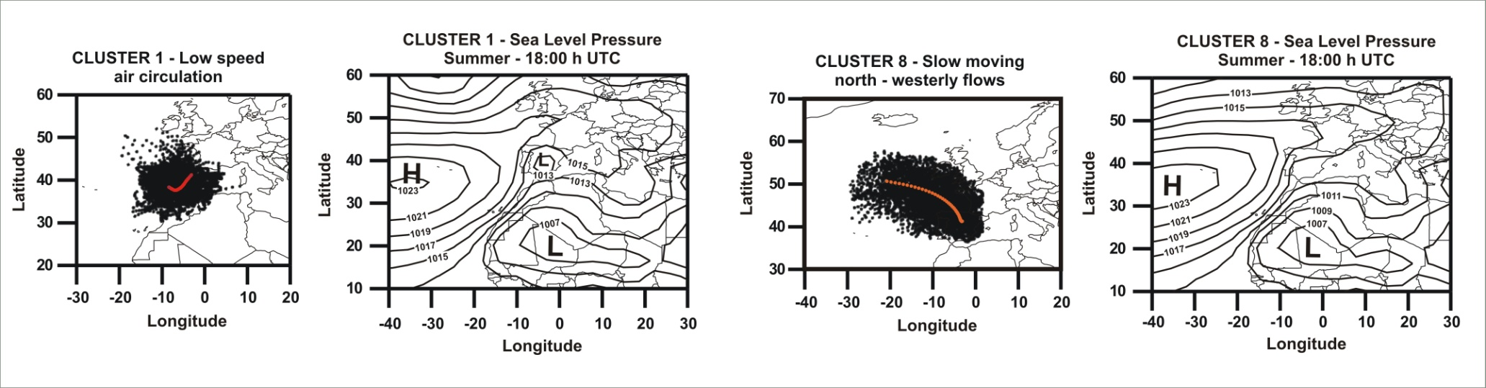
TSM – CLUSTER ANALYSIS - METHODOLOGY
Cluster Analysis
STEP 3: recalculate the cluster centers after all the trajectories have been examined and assigned
A cluster center is the arithmetic mean of all members of a cluster:
X_{k} is the cluster center of cluster k
n_{m} in the number of members in cluster k
X_{jk} is trajectory j in cluster k

Slide 17
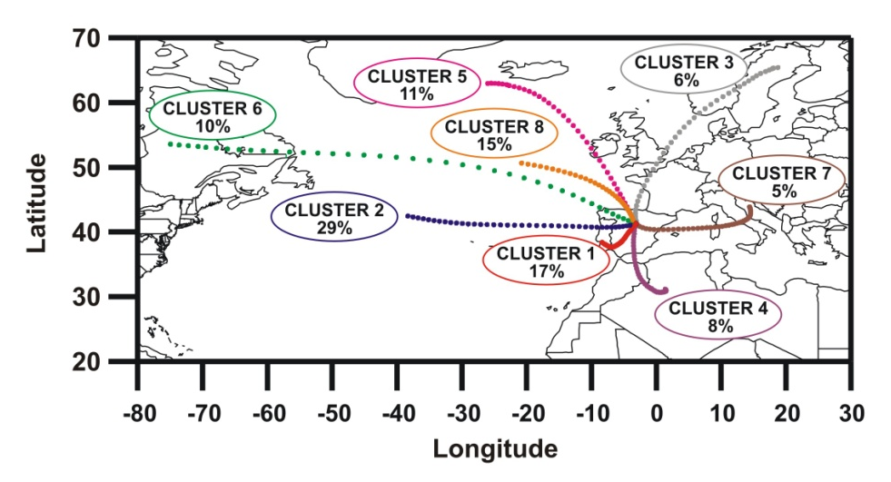
TSM – CLUSTER ANALYSIS - METHODOLOGY
Cluster Analysis
STEP 4: repeat the process
Steps 2 and 3 can be repeated:
a specified number of times
until no trajectory or a specified number of trajectories changes its cluster assignment
The point at which no trajectories change cluster assignment is referred to as convergence
Result of a CA:

Slide 18
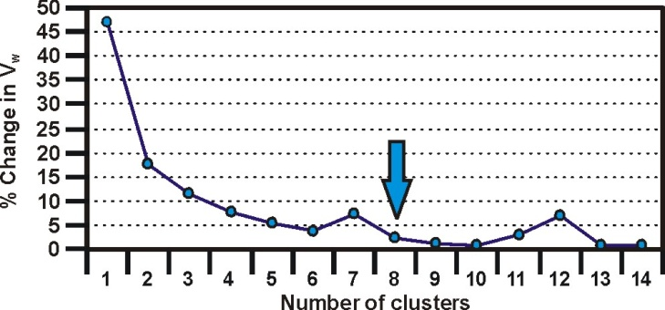
TSM – CLUSTER ANALYSIS - METHODOLOGY
Cluster Analysis
SELECTION OF THE NUMBER OF CLUSTERS
The general use of variance plots is to identify features that would indicate the correct number of clusters to be chosen for the data set
These features are usually abrupt changes in slope or simply passing a threshold value (5% of percent change of the within-cluster variance, Brankov et al., 1998)
Vw is calculated as the sum of the root-mean-square deviations of each trajectory from its cluster center:
n_{c} is the number of clusters
n_{m} is the number of the members of cluster k
n_{p} is the number of time steps in trajectory j
ed_{ijk} is the distance from point i on trajectory j to time step i on cluster center k
The percentage change in within-cluster variance Vw is computed as a function of the number of clusters and plotted:
% Vw_{n} is the percent change of the within-cluster variance at number of clusters n
Vw_{n} is the value for the within-cluster variance at n number of clusters

Slide 19
TSM – CLUSTER ANALYSIS - METHODOLOGY
Cluster Analysis
SELECTION OF THE NUMBER OF CLUSTERS
A large increase in the Vw statistic appeared when reducing the number of clusters from 13 to 12 and from 8 to 7
This suggested that 13 or 8 clusters could be retained as the best number for describing significantly different air-flow patterns

Slide 20

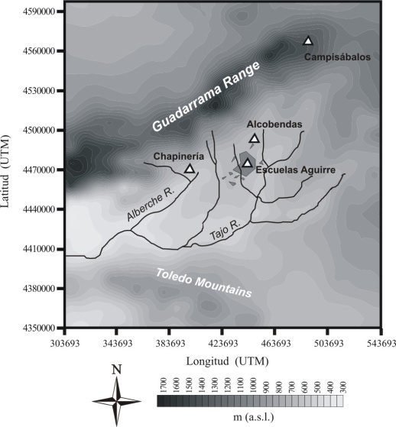

TSM – CLUSTER ANALYSIS - RESULTS
Cluster Analysis – Synoptic Meteorological Classification
Each cluster defines a characteristic meteorological synoptic situation
You can obtain sea level pressure and geopotential heigh composite maps for each synoptic situation, by means of the daily fields for each day assigned to each cluster: http://www.cdc.noaa.gov/Composites/Hour/
CA – centre of the Iberian Península, a case study (Salvador et al., 2008)
Set of 10,204 trajectories (FLEXTRA) with origin in Campisábalos (EMEP)
Period of study 1999 - 2005
8 typical meteorological synoptic situation (clusters) were obtained
The incidence of each meteorological synoptic situation on the levels and chemical composition of APM was studied

Slide 21
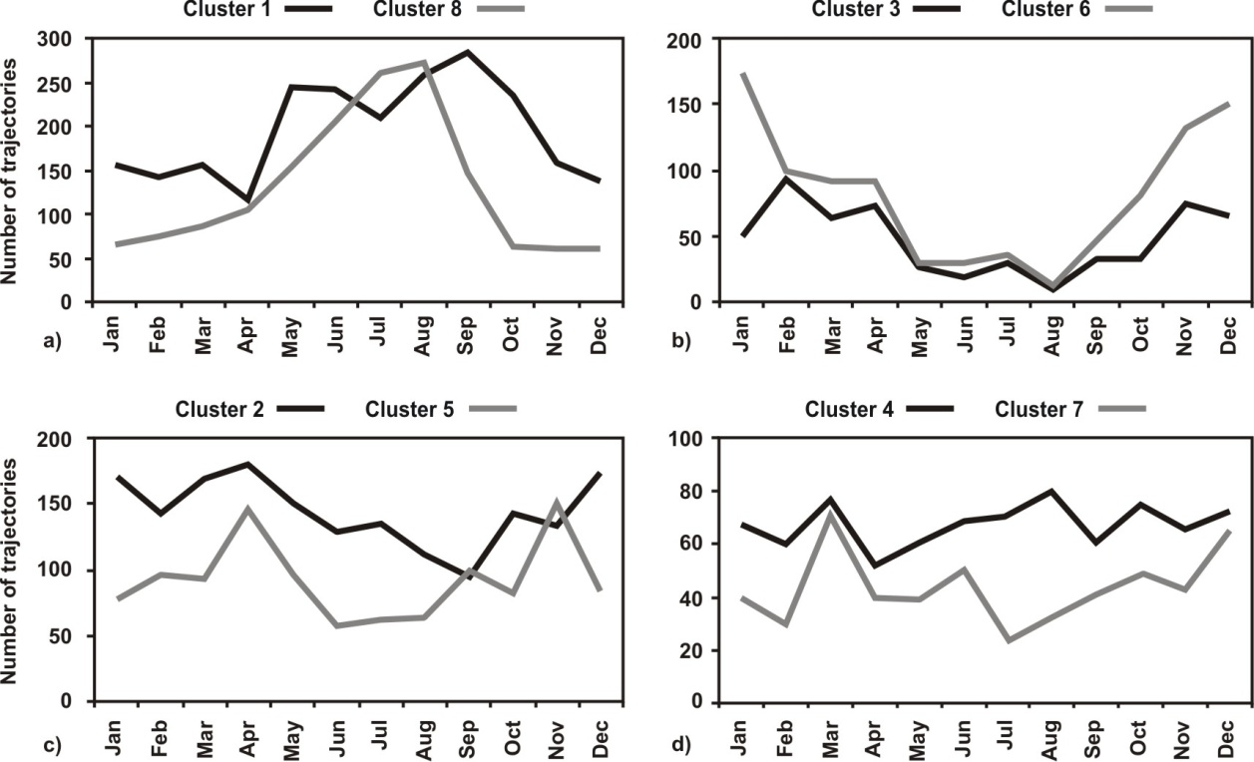
TSM – CLUSTER ANALYSIS - RESULTS
Cluster Analysis – Synoptic Meteorological Classification
AIR MASSES FLOWS IN SUMMER
The slowest air flows (clusters 1 and 8) were detected in this period as a consequence of the influence of the Azores high pressure system over the Iberian Península
Development of regional air flows (land/sea breezes, relief winds)
Development of the atmospheric boundary layer by convection processes

Slide 22
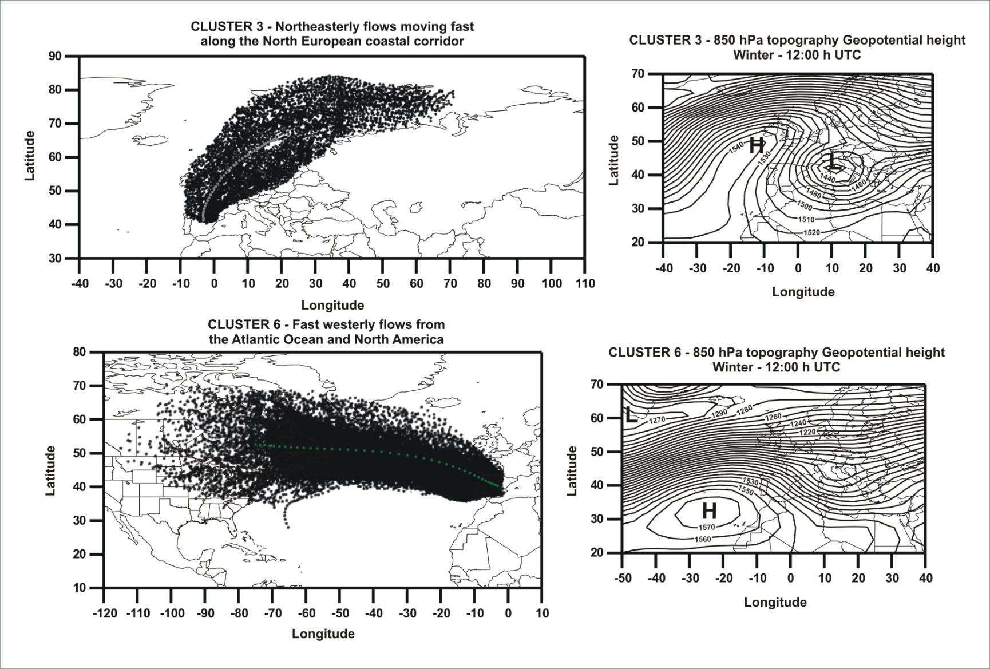
TSM – CLUSTER ANALYSIS - RESULTS
Cluster Analysis – Synoptic Meteorological Classification
AIR MASSES FLOWS IN WINTER
The fastest air flows (clusters 3 and 6) were detected in this period associated to intense pressure gradients

Slide 23
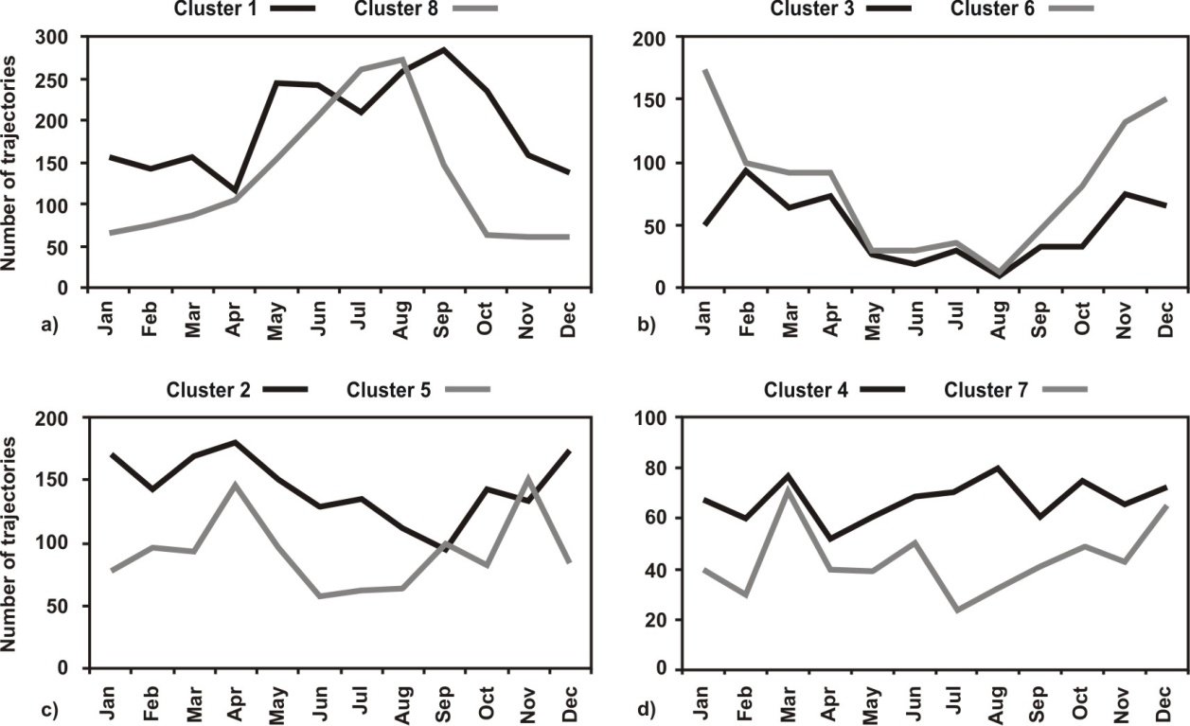
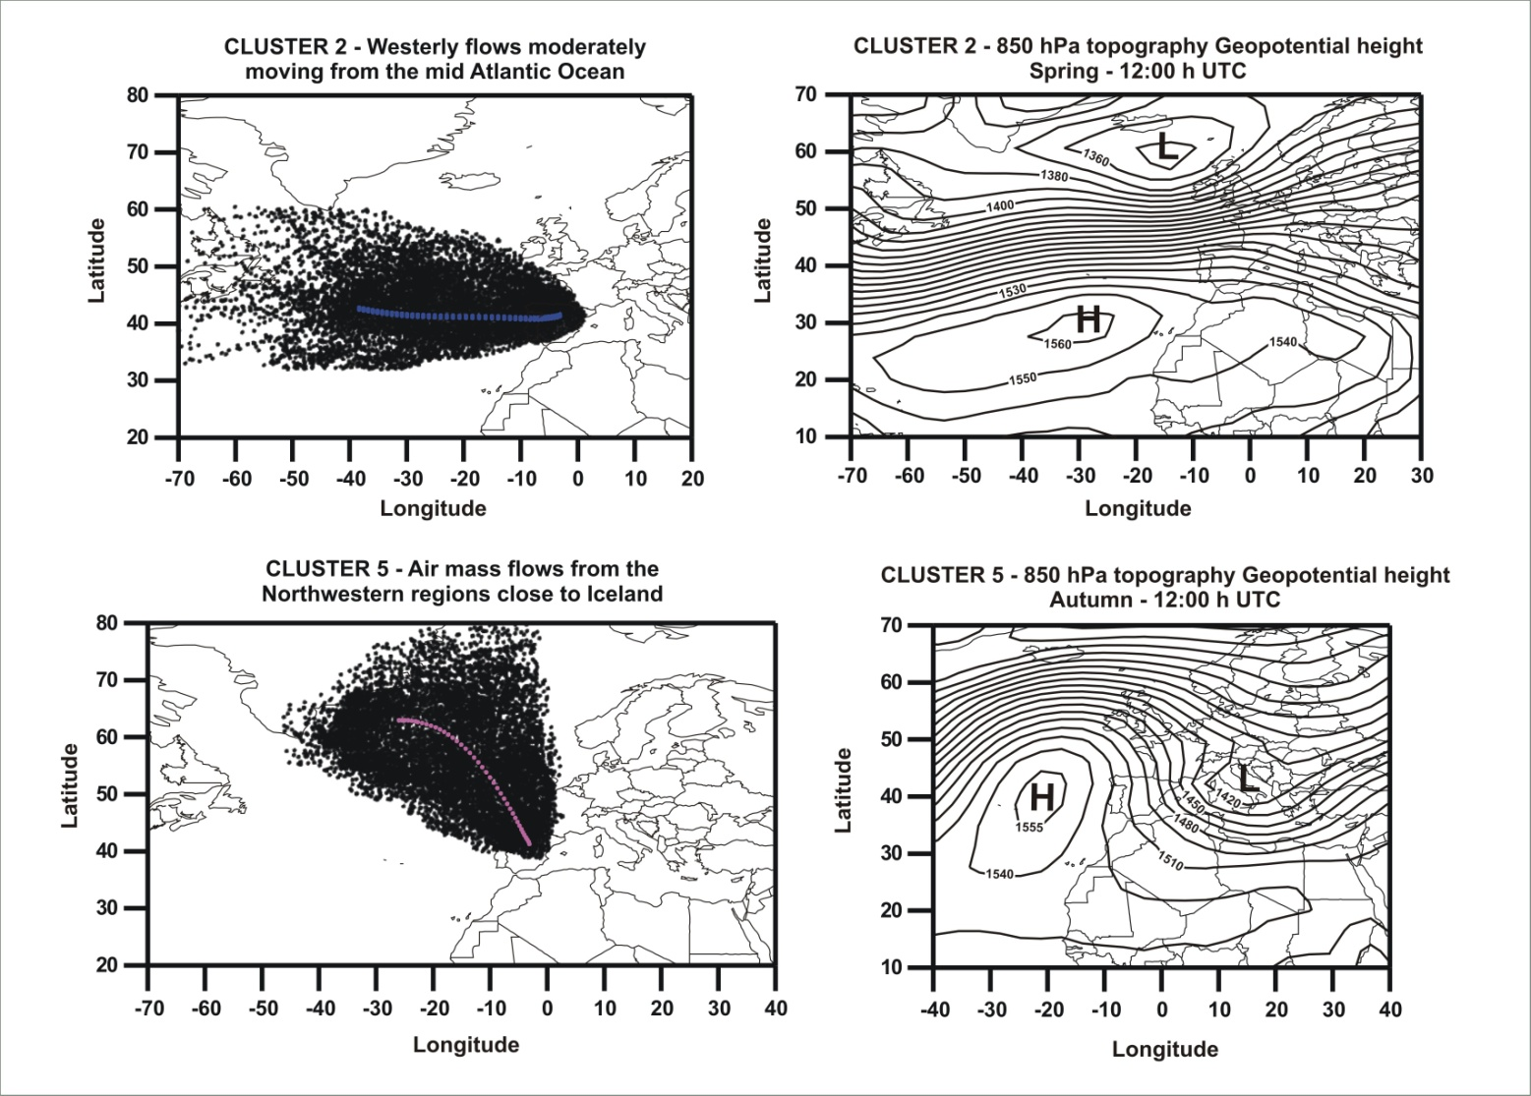
TSM – CLUSTER ANALYSIS - RESULTS
Cluster Analysis – Synoptic Meteorological Classification
AIR MASSES FLOWS IN SPRING AND AUTUMN
The advection of moderately fast flows from Northern and Western Atlantic regions (clusters 2 and 5) were frequently produced in the transition seasons

Slide 24
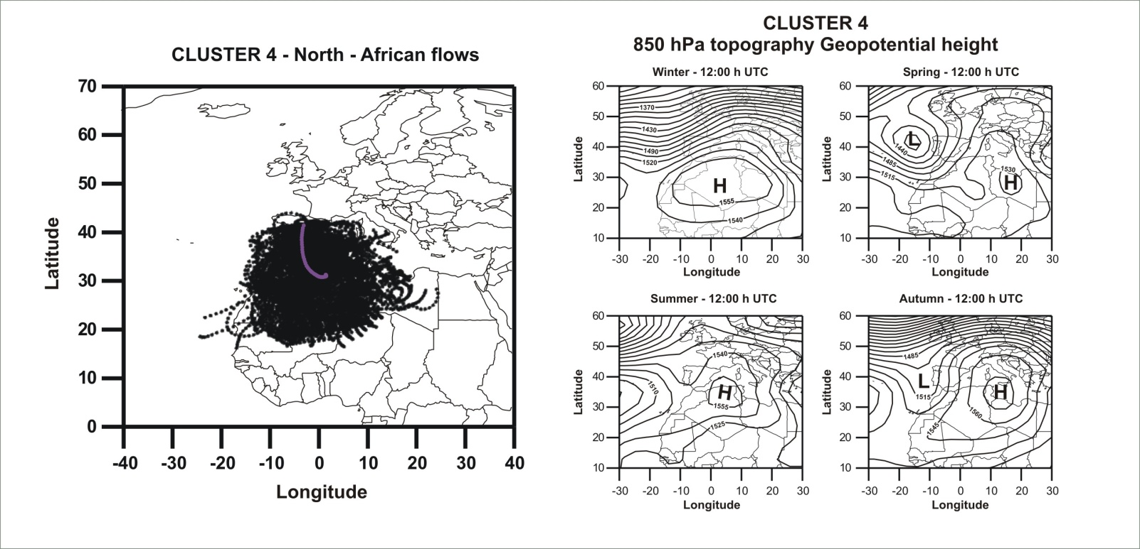
TSM – CLUSTER ANALYSIS - RESULTS
Cluster Analysis – Synoptic Meteorological Classification
AIR MASSES FLOWS WITHOUT A CLEAR SEASONAL PATTERN
The transport of air masses from North-African regions (cluster 4) was more frequently produced in March, August, October and December

Slide 25
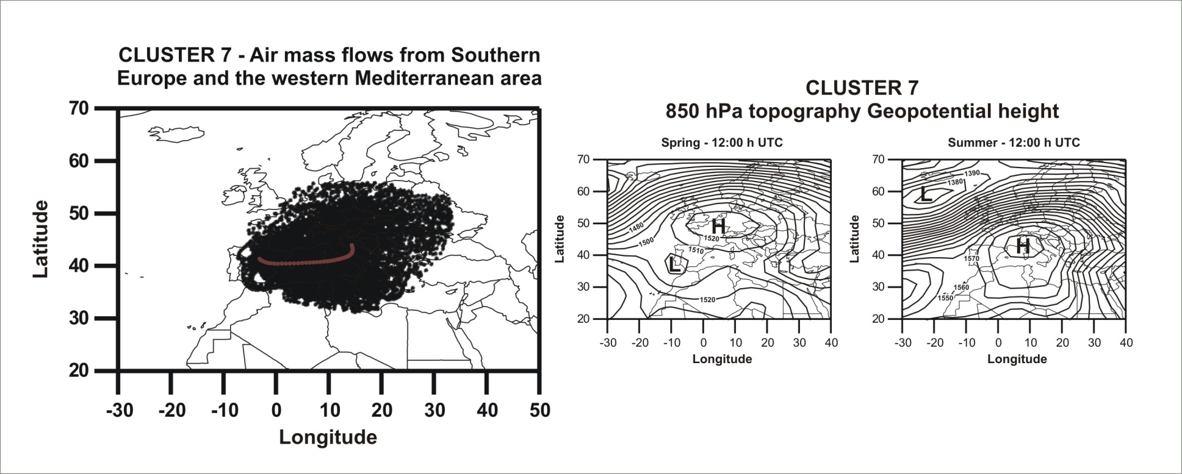
TSM – CLUSTER ANALYSIS - RESULTS
Cluster Analysis – Synoptic Meteorological Classification
AIR MASSES FLOWS WITHOUT A CLEAR SEASONAL PATTERN
The transport of the air masses from European regions across the Mediterranean basin (cluster 7) was more frequently produced in March, June and December

Slide 26
TSM – CLUSTER ANALYSIS - RESULTS
INFLUENCE OF THE CLUSTERS ON LEVELS AND
CHEMICAL COMPOSITION OF APM
The non-parametric Kruskal-Wallis test -> can be used to test the significance of inter-cluster variation in APM concentration
This technique tests the null hypothesis that several samples have been drawn from the same population
If the test leads to the rejection of the null hypothesis it must be interpreted as:
“APM levels at the sampling site are influenced by the arriving air mass flows, which are represented by the different clusters obtained”
Multiple sample comparison test -> can be used to find out which clusters are significantly different from which others
These tests can be found in any Statisticall software package

Slide 27
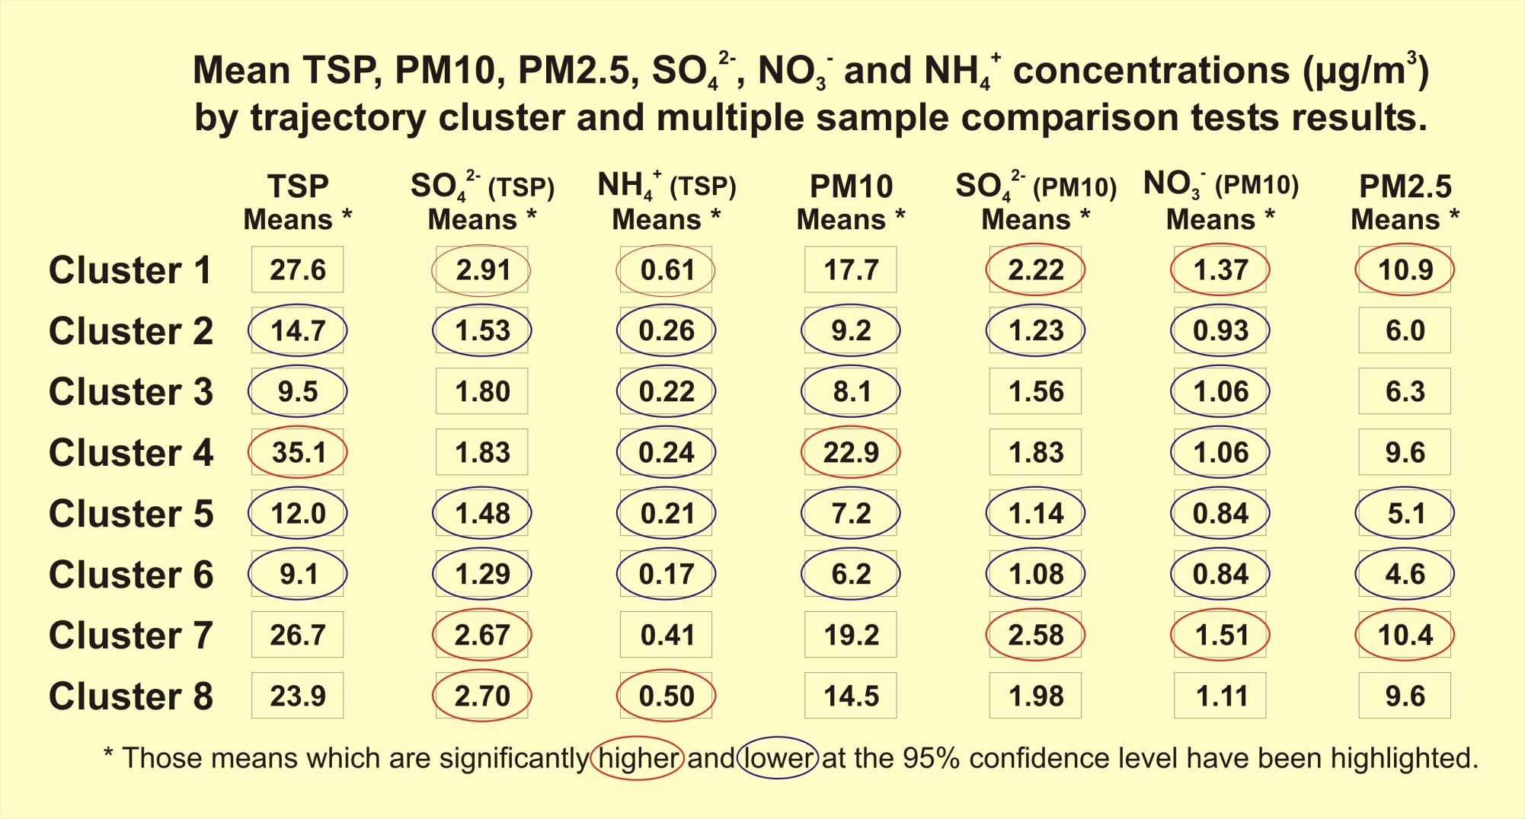
TSM – CLUSTER ANALYSIS - RESULTS
INFLUENCE OF THE CLUSTERS ON LEVELS AND
CHEMICAL COMPOSITION OF APM
CA – centre of the Iberian Península, a case study (Salvador et al., 2008)

Slide 28
TSM – CLUSTER ANALYSIS - CONCLUSIONS
Cluster Analysis
CA is a useful “objective” methodology for back-trajectories classifications
CA allows estimating the incidence of the origin of the air masses on the levels and chemical composition of APM
The determination of synoptic climatologies can be used in future studies and in the development of local strategies devoted to the reduction of APM levels
CA does not provide detailed information on the geographical region of potential sources of APM
Residence Time Analysis
Concentration Fields

Slide 29
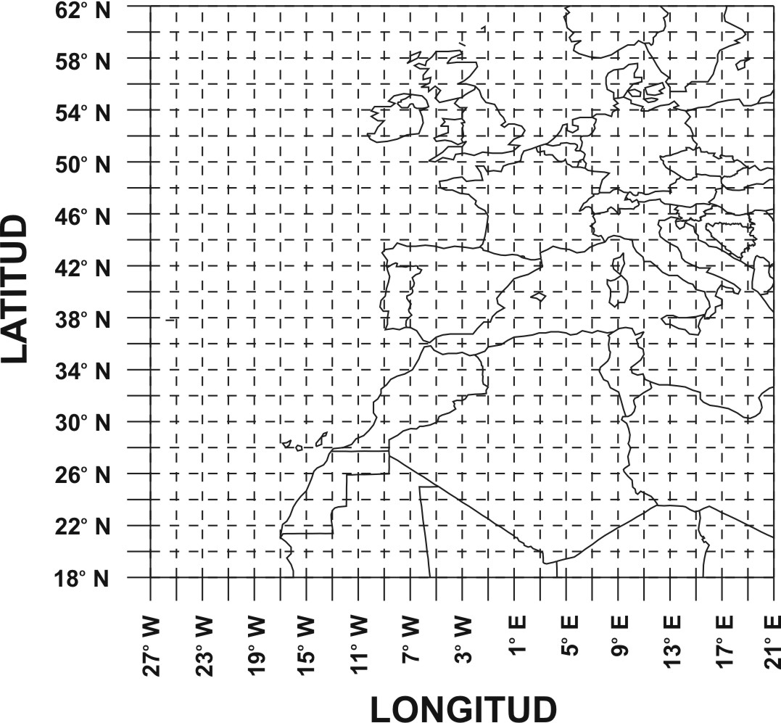
TSM – RESIDENCE TIME ANALYSIS - METHODOLOGY
Residence Time Analysis
CPF_{ij} = Conditional Probability Function for the grid cell ij (Ashbaugh et al., 1985)
CPF_{ij} = m_{ij} / n_{ij}
(i, j) = index of the grid cell ij
n_{ij} = number of time steps from all the trajectories computed during the sampling period, residing or contained in the grid cell ij
m_{ij} = number of time steps from all the trajectories computed during “high incident days” residing or contained in the grid cell ij
“high incident days” for a given APM component – days with concentrations values higher or lower than a given value (> 90th or < 10th percentile)
This function represents the probability that an air mass arrives at the receptor site during “high incident days”, after having been observed to reside in a specific geographic area (grid cell)

Slide 30
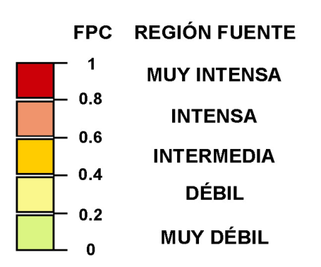
TSM – RESIDENCE TIME ANALYSIS - METHODOLOGY
Residence Time Analysis
Areas with high CPF can be considered as source regions of the APM component under study or
as preferred air mass pathways
(Zeng and Hopke, 1989)
Different tests can be used to check the statistical significance of every CPF_{ij} value
A “point filter”-> grid cells counting less than X time steps or trajectories are not taken into account. It is somewhat subjective
The “binomial test” (Vasconcelos et al., 1996) which assumes that the CPF is the parameter p of the binomial distribution
A smooth of the map by a low-pass filter (9-point filter) which assures that significant variations are preserved while most of the insignificant ones are removed
Using bootstrapping techniques (Hopke et al., 1995)

Slide 31
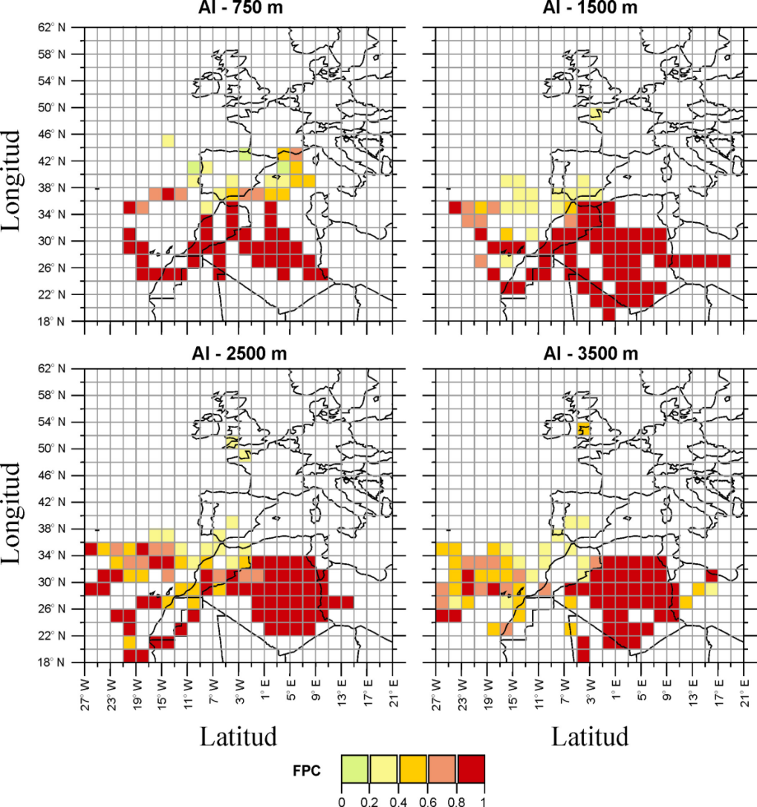
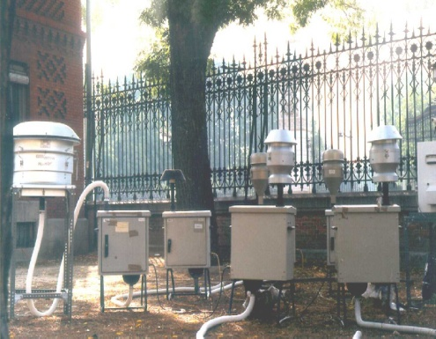
TSM – RESIDENCE TIME ANALYSIS - RESULTS
RTA – urban traffic site in Madrid, a case study (Salvador et al., 2004)
POTENTIAL SOURCE REGIONS OF DESERT DUST
(Tracer - Al)
Madrid
URBAN - ROAD TRAFFIC
Potential source regions: Algeria, Western Sahara and Morocco

Slide 32
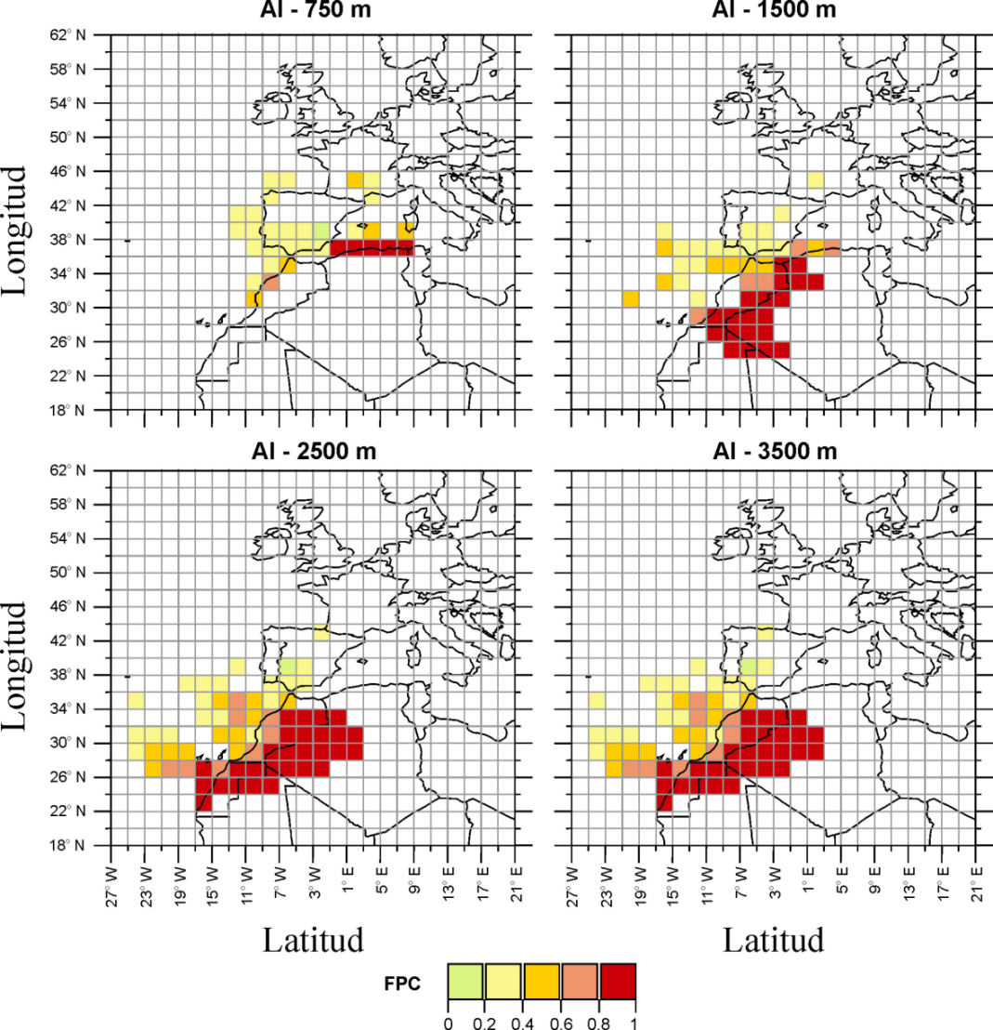
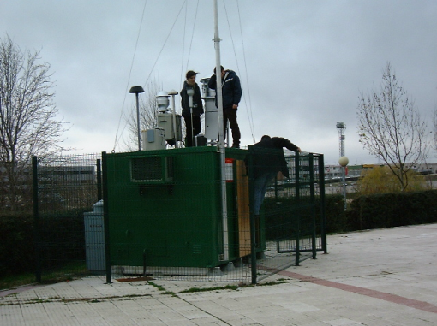
TSM – RESIDENCE TIME ANALYSIS - RESULTS
POTENTIAL SOURCE REGIONS OF DESERT DUST
(Tracer - Al)
Alcobendas
URBAN BACKGROUND
Potential source regions: western Algeria, Mauritania, Western Sahara and Morocco

Slide 33
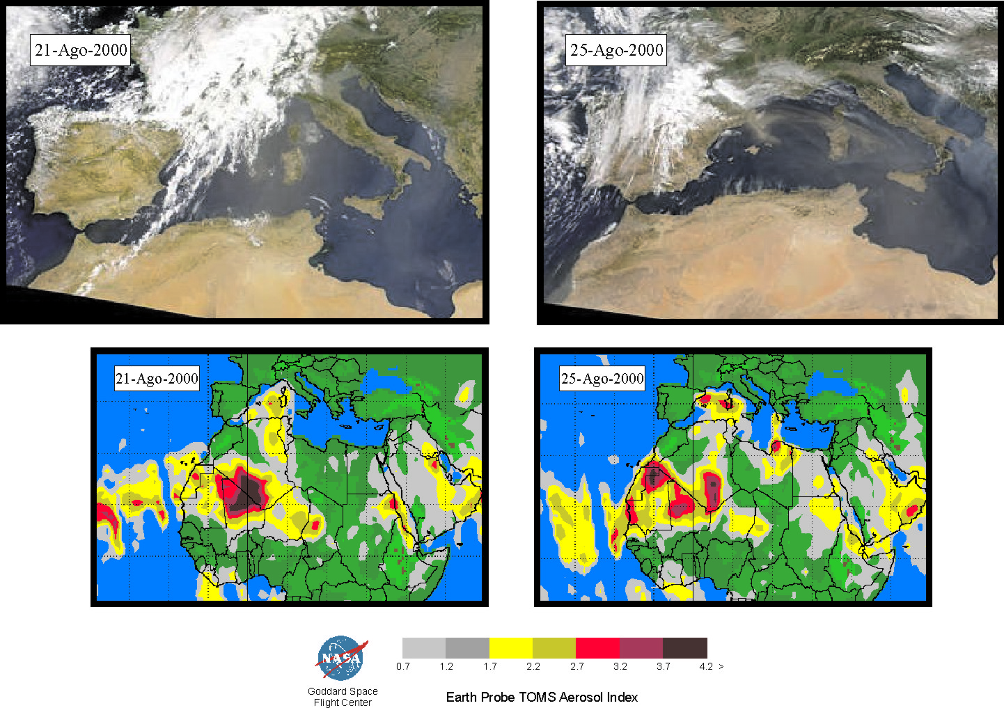
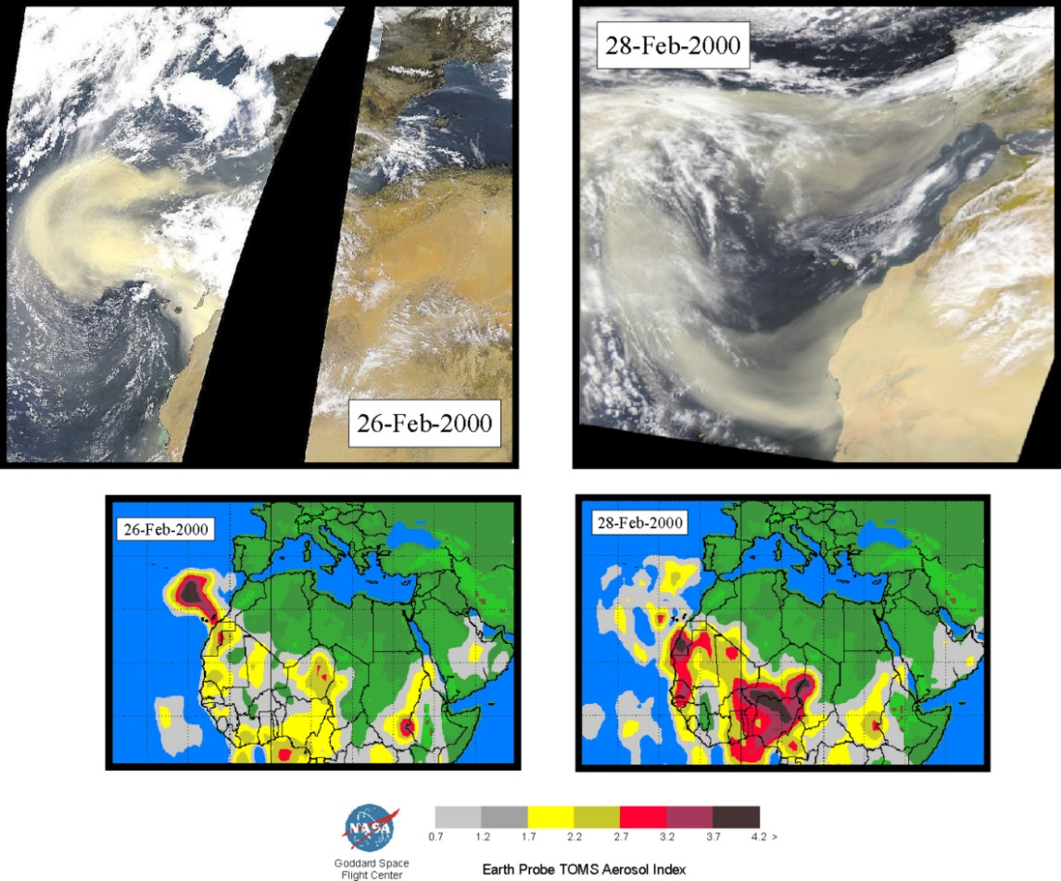
TSM – RESIDENCE TIME ANALYSIS - RESULTS
POTENTIAL SOURCE REGIONS OF DESERT DUST

Slide 34
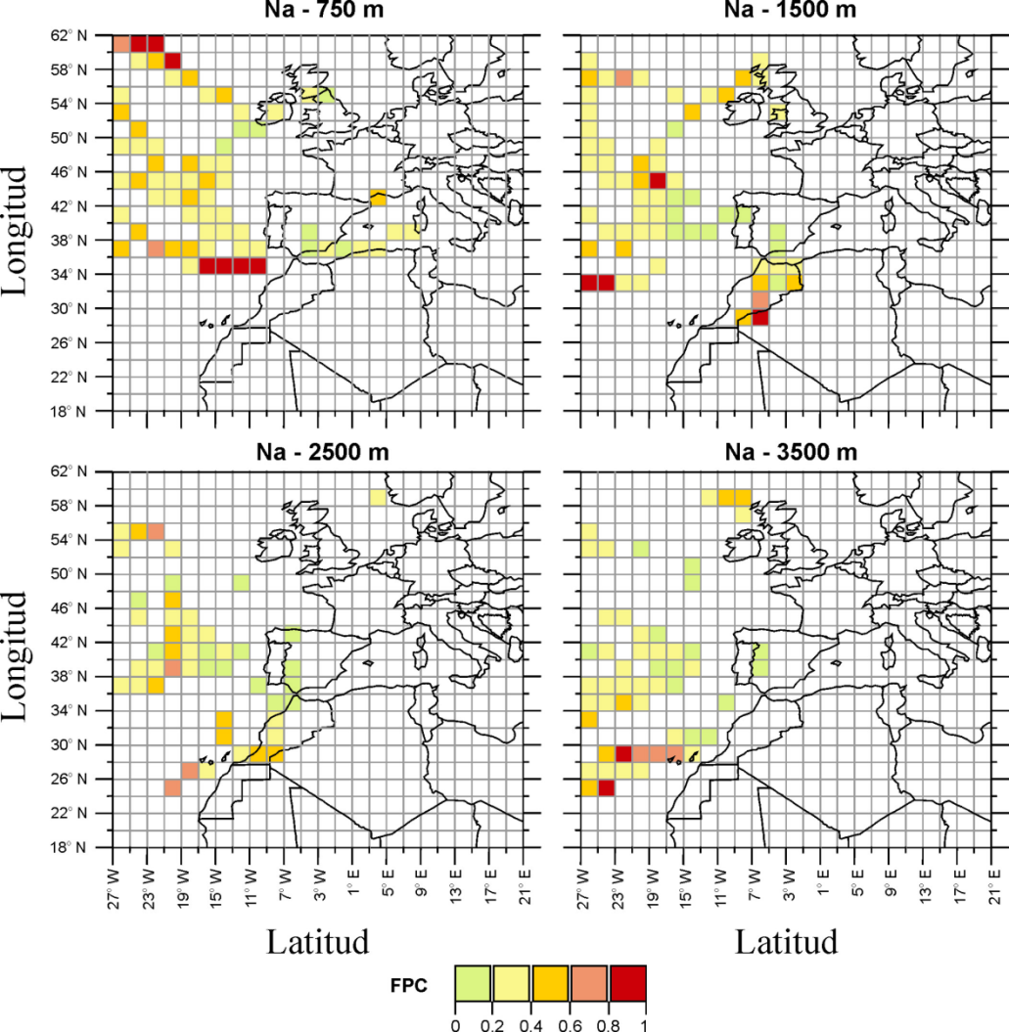
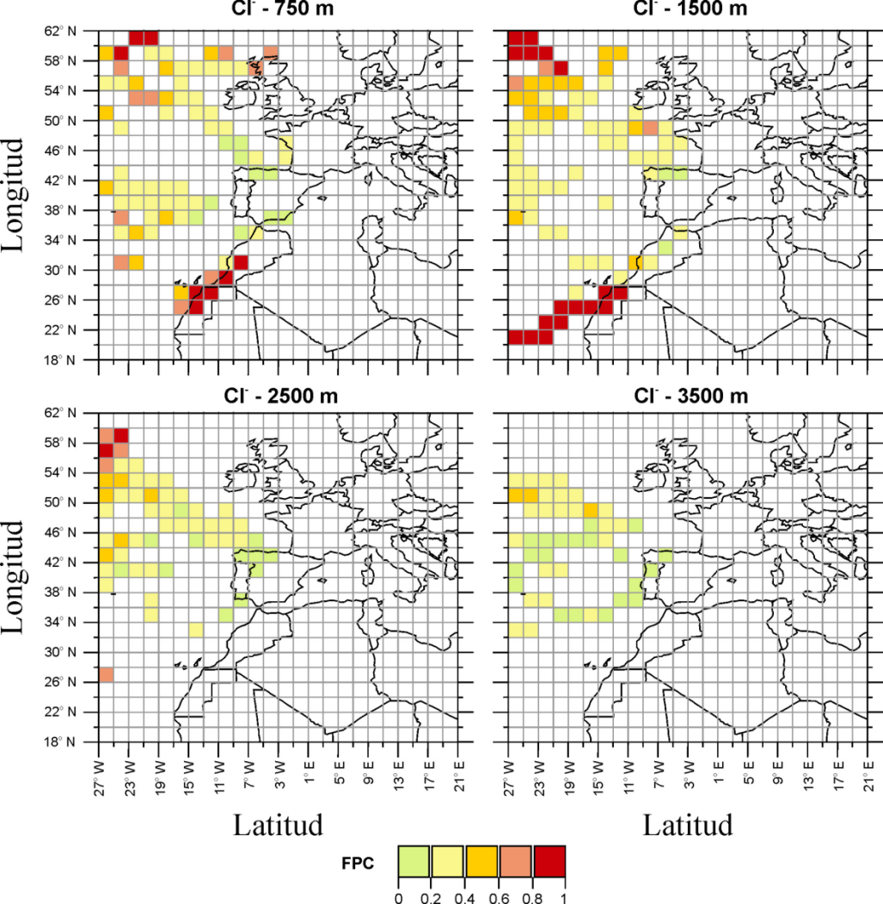
TSM – RESIDENCE TIME ANALYSIS - RESULTS
POTENTIAL SOURCE REGIONS OF MARINE AEROSOL
(Tracer – Na, Cl⁻)
URBAN TRAFFIC SITE (MADRID)
URBAN BACKGROUND SITE (ALCOBENDAS)
Potential source regions: Sectors of the Atlantic Ocean

Slide 35
TSM – CONCENTRATIONS FIELDS - METHODOLOGY
Concentration Fields Methodology
I – Computing the initial CF (Seibert et al., 1994)
Step 1: taking the logarithm of the data C (a component of APM)
APM concentrations are distributed log-normally and thus are transformed into a normally distributed form required for standard statistics
Step 2: for each cell ij of the grid which was superimposed to the domain of the trajectory calculations, a logarithmic mean concentration is calculated:
(i, j) = index of the grid cell ij
l = index of the trajectory
m = total number of trajectories
C_{l} = concentration observed on arrival of the trajectory l
n_{ijl} = The time spent in grid cell ij by trajectory l
(number of time steps of the trajectory l contained in the grid cell ij)

Slide 36
TSM – CONCENTRATIONS FIELDS - METHODOLOGY
Concentration Fields Methodology
I – Computing the initial CF (Seibert et al., 1994)
It is a weighted mean concentration of C values in grid cells, in which the weight for each C_{l} value is the time spent in grid cell ij by trajectory l
Step 3: A confidence interval of the 100(1- α)% for the mean value C_{ij} is calculated:
SD_{ij} = standard deviation of C_{ij}
n_{ij} = total number of trajectories passing through the grid cell ij
t_{(a,b)} = value of the a_{th} percentile of the t distribution with b degrees of freedom
α = significant level
Step 4: The concentration field is smoothed with a 9-point filter, imposing the restriction that the values must be keept within their confidence interval
The smoothing procedure assures that significant variations are preserved while most of the insignificant ones are removed

Slide 37
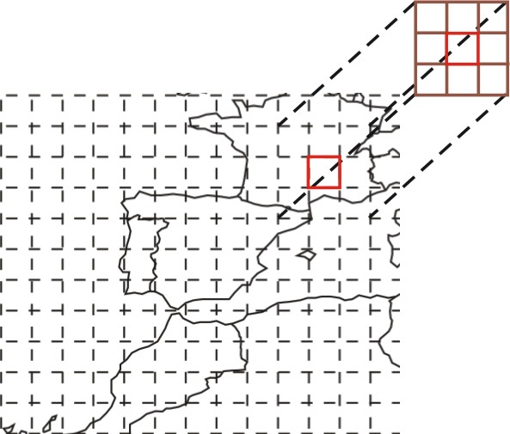
TSM – CONCENTRATIONS FIELDS - METHODOLOGY
Concentration Fields Methodology
I – Computing the initial CF (Seibert et al., 1994)
A 9-point filter is a low pass filter used for digital image data treatment
For each Cij value the average between the grid cell ij value (probability or concentration) and the neighbouring cell values is calculated according to:
Removes the local variability and the random noise, thus the overall pattern becomes more clearly apparent

Slide 38
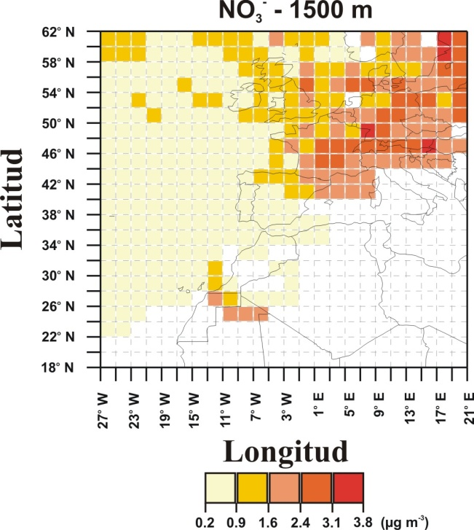
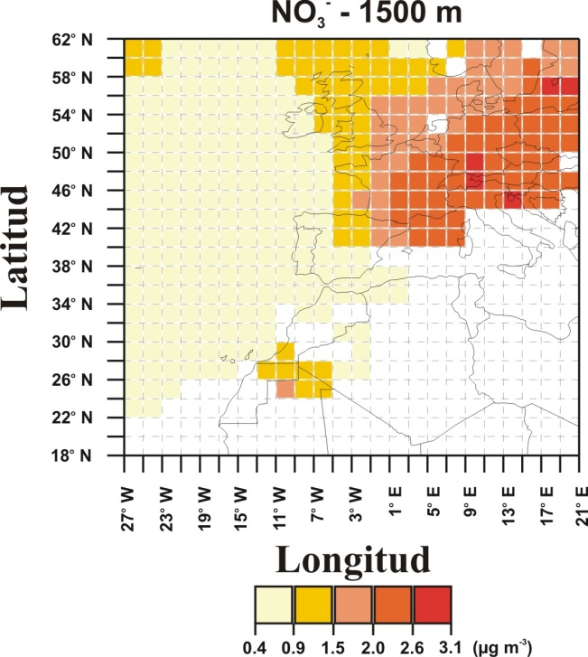
TSM – CONCENTRATIONS FIELDS - METHODOLOGY
Concentration Fields Methodology
I – Computing the initial CF (Seibert et al., 1994)
Smoothed
CF
Initial CF

Slide 39
TSM – CONCENTRATIONS FIELDS - METHODOLOGY
Concentration Fields Methodology
II - Computing the Redistributed CF (Stohl, 1996)
The Seibert procedure does not extract all the information from the data, because the measured concentration is equally attributted to all time steps of the related trajectory
Real sources of air pollutants are often concentrated in “hot spots”
Hence, this method underestimates the gradients of the “true” CF
Stohl (1996) proposed using the initial CF obtained with the Seibert method to redistribute the concentrations along the trajectories
l = index of the trajectory; l = 1,…, m
p = index of the time steps of the trajectory l; p = 1,…,N_{l}
C_{pl} = concentration for the time step p of the trajectory l
C_{l} = concentration observed on arrival of the trajectory l
C_{ijpl} = concentration of the grid cell ij in the initial CF, where the time step p of the trajectory l resided
C_{ijpl} = average of the concentrations of the grid cells in the initial CF, hit by the N_{l} time steps of the trajectory l

Slide 40
TSM – CONCENTRATIONS FIELDS - METHODOLOGY
Concentration Fields Methodology
II - Computing the Redistributed CF (Stohl, 1996)
Step 5: After the redistribution is applied to all trajectories, a new CF can be computed with:
n_{ijpl} = is the residence time in the grid cell ij of the time step p of the trajectory l
Step 6: The concentration field is smoothed with a 9-point filter, imposing the restriction that the values must be keept within their confidence interval

Slide 41


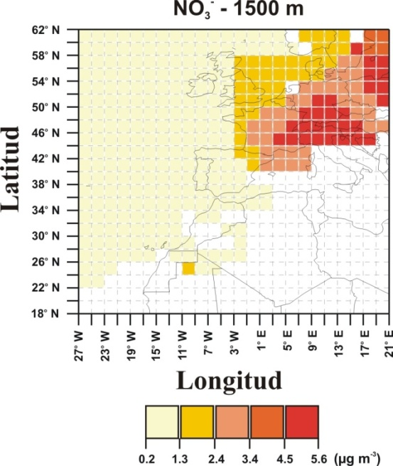
TSM – CONCENTRATIONS FIELDS - METHODOLOGY
Concentration Fields Methodology
II - Computing the Redistributed CF (Stohl, 1996)
Smoothed
CF
Final
RCF
Initial CF

Slide 42
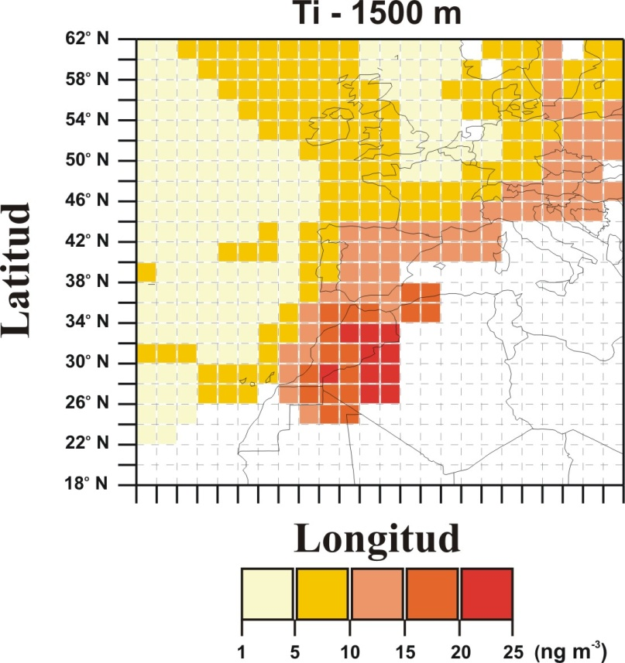
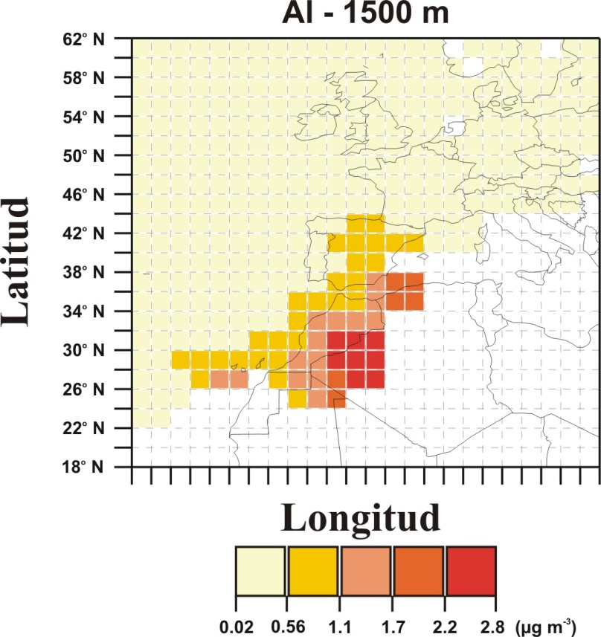
TSM – CONCENTRATIONS FIELDS - RESULTS
RCF – regional background site in NW IP (Bemantes), a case study (Salvador et al., 2007)
POTENTIAL SOURCE REGIONS OF MINERAL DUST
(Tracers – Ti, Al)
Bemantes
REGIONAL BACKGROUND
Potential source regions: western Algeria and Morocco

Slide 43
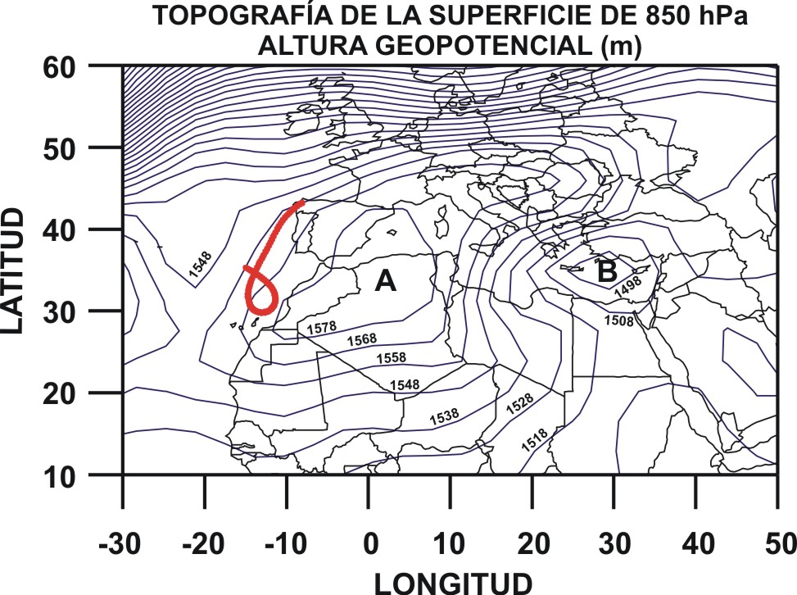
TSM – CONCENTRATIONS FIELDS - RESULTS
COMBINING RESULTS FROM DIFFERENT TSM: CA AND RCF
POTENTIAL SOURCE REGIONS OF MINERAL DUST
(Tracers – Ti, Al)
Cluster 1: Northafrican flows
Potential source regions: western Algeria and Morocco

Slide 44
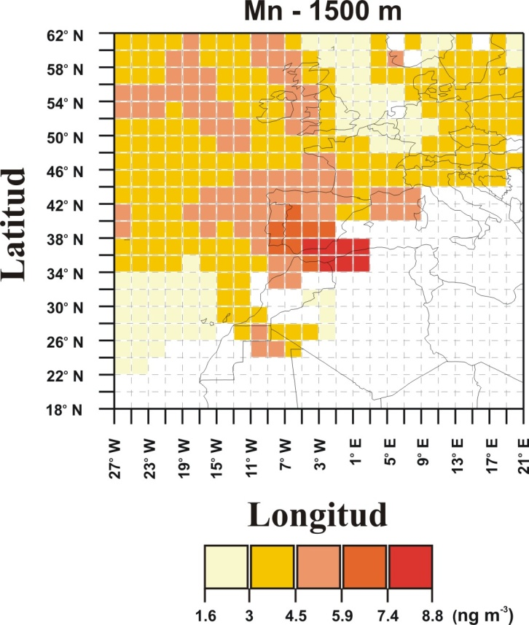
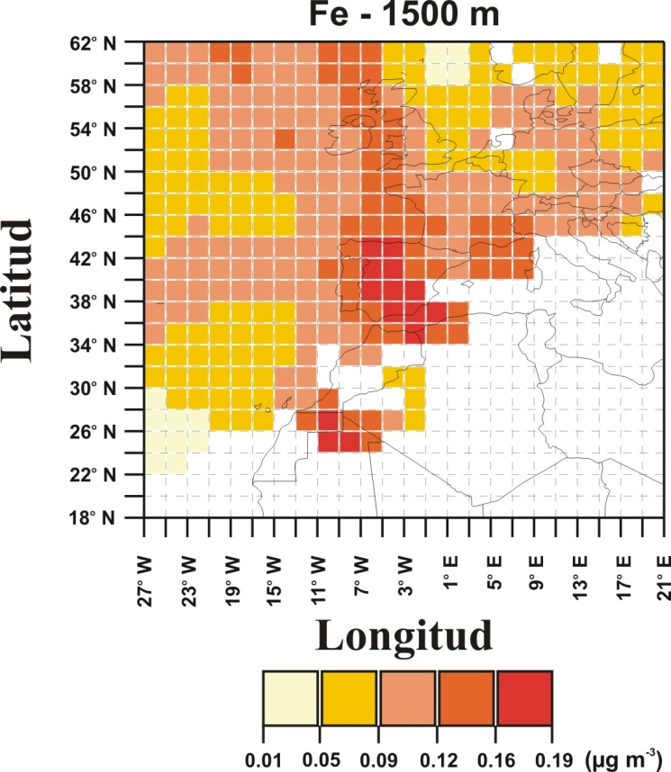
TSM – CONCENTRATIONS FIELDS - RESULTS
POTENTIAL SOURCE REGIONS OF MINERAL DUST
(Tracers – Mn, Fe)
Potential source regions: the Iberian Peninsula
It is interpreted as the contribution from local and regional soil dust as a
result of resuspension by wind and convective processes

Slide 45
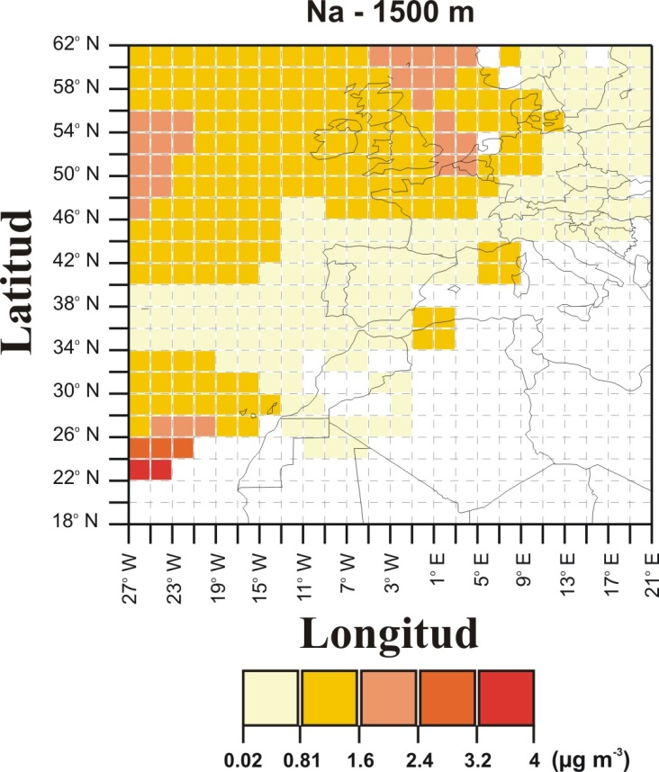
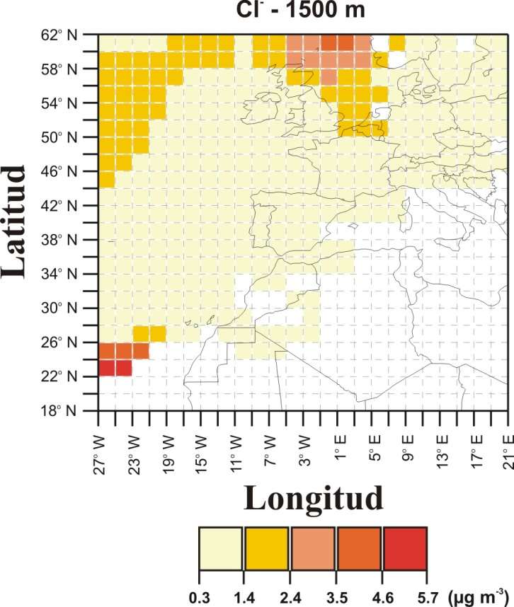
TSM – CONCENTRATIONS FIELDS - RESULTS
POTENTIAL SOURCE REGIONS OF MARINE AEROSOL
(Tracers – Na, Cl⁻)
Potential source regions: Atlantic Ocean areas

Slide 46
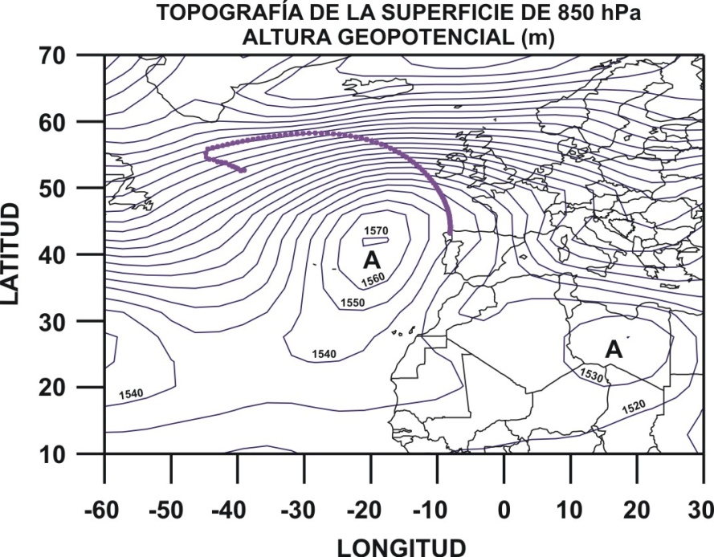
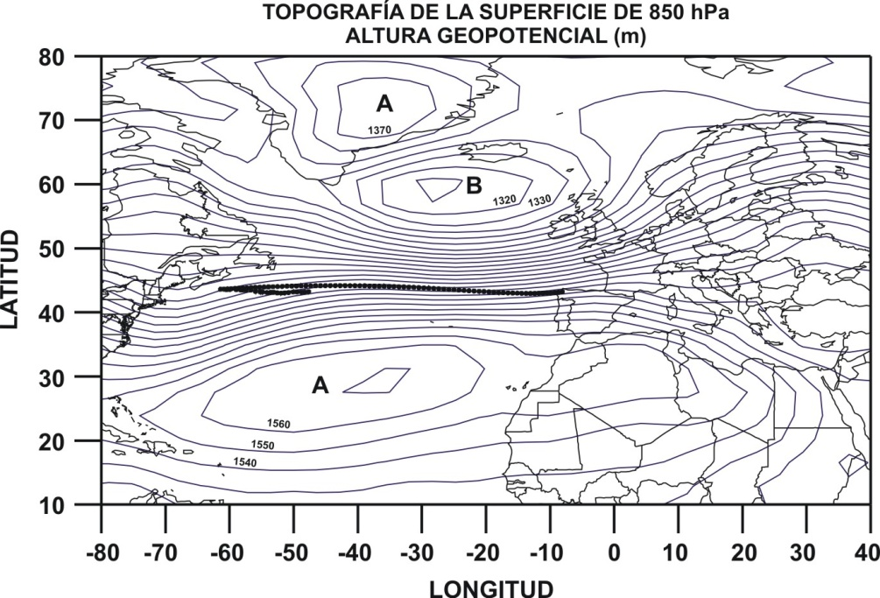
TSM – CONCENTRATIONS FIELDS - RESULTS
POTENTIAL SOURCE REGIONS OF MARINE AEROSOL
(Tracers – Na, Cl⁻)
Simultaneous sharp increases of Na and Cl⁻ during
advections of Atlantic air masses associated to frontal systems
Cluster 2: Northeasterly flows
Cluster 3: Easterly flows

Slide 47
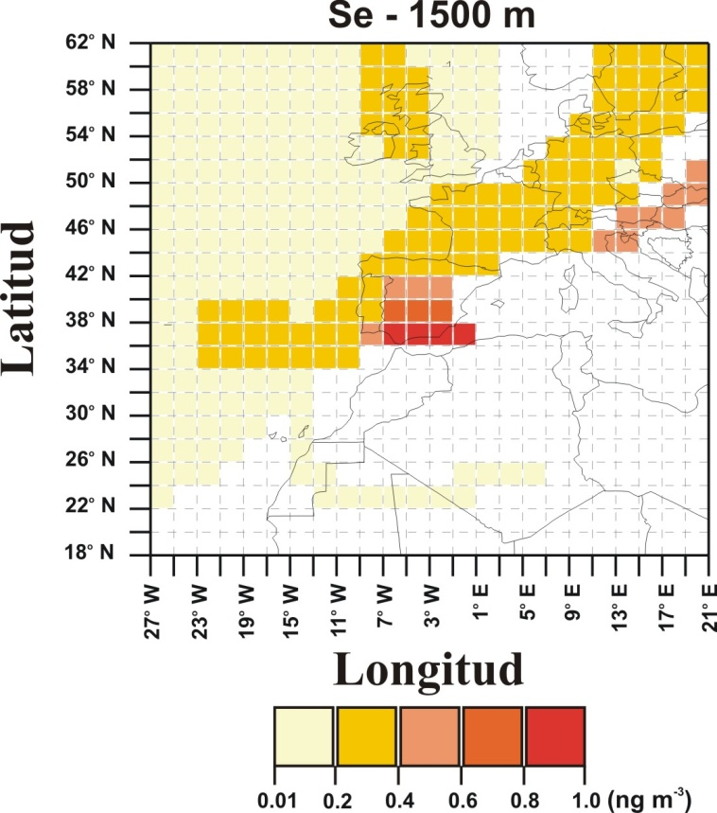
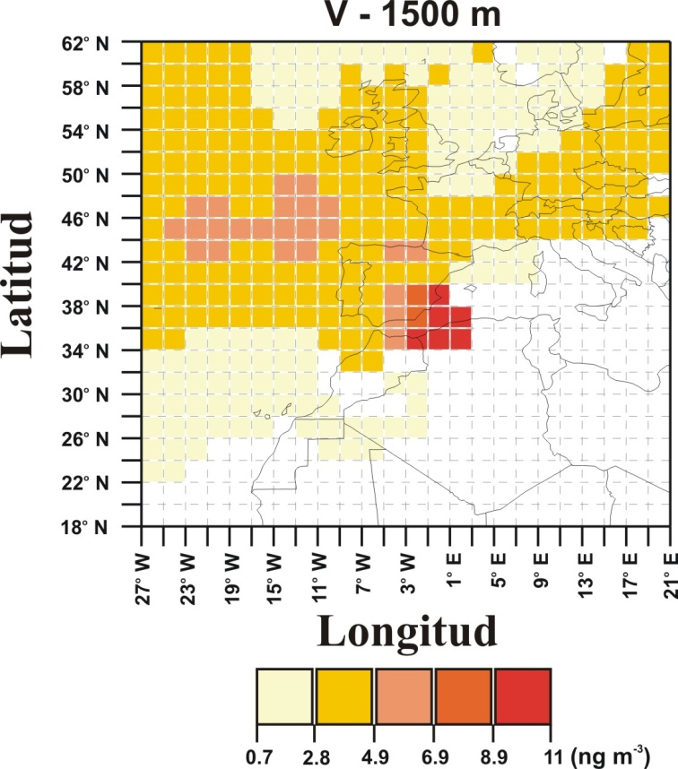
TSM – CONCENTRATIONS FIELDS - RESULTS
POTENTIAL SOURCE REGIONS OF COMBUSTION PROCESSES
(Tracers – Se (coal), V (fuel-oil))
Potential Source regions: over and nearby the Iberian Peninsula

Slide 48


TSM – CONCENTRATIONS FIELDS - RESULTS
POTENTIAL SOURCE REGIONS OF AMMONIUM SULPHATE
(Tracers – SO₄²⁻, NH₄⁺)
Potential Source regions: over and nearby the Iberian Peninsula

Slide 49

TSM – CONCENTRATIONS FIELDS - RESULTS
The highest concentrations were recorded during periods of regional
atmospheric circulations under high insolation conditions
Cluster 4: Regional flows
This meteorological scenario is typically produced in summer
favours transport from distant sources at a regional scale
fumigation episodes of emissions plumes (SO₂ and fly-ashes) from power plants
formation of particles of (NH₄)₂SO₄ by photochemical conversion
convective dynamics that cause dust resuspension

Slide 50

TSM – CONCENTRATIONS FIELDS - RESULTS
POTENTIAL SOURCE REGIONS OF NITRATE
(Tracers – NO₃⁻)
Potential Source regions: eastern and central Europe

Slide 51


TSM – CONCENTRATIONS FIELDS - RESULTS
POTENTIAL SOURCE REGIONS OF NITRATE
(Tracers – NO₃⁻)
Cluster 5: European flows
Emisiones totales de NO_{x} en 2001
http://webdab.emep.int
Transport of NO₃⁻ from highly polluted European urban and industrial regions

Slide 52

TSM – CONCENTRATIONS FIELDS - RESULTS
POTENTIAL SOURCE REGIONS OF CARBON
(Tracer – C)
No meaningful results!!!

Slide 53

TSM – CONCENTRATIONS FIELDS - RESULTS
POTENTIAL SOURCE REGIONS OF CARBON
(Tracer – C)
Cluster 6: Slow easterly flows
RCF for C represents transport pathways of air masses produced
by persistent synoptic situations during anthropogenic local episodes:
high-pressure systems over the Iberian Peninsula
Situations of high atmospheric stability
Surface layer is decoupled from higher atmospheric layers

Slide 54

TSM – RESULTS
Remote background sites in central Europe, a case study (Salvador et al., 2010)
APM was sampled from October 2002 to October 2004 at 3 remote background sites in central Europe: Puy de Dôme-PDD (France), Schauisland-SIL (Germany) and Sonnblick-SBO (Austria)
Weekly samples of PM10 (PDD and SIL) and PM2.5 (SBO) were analyzed for determining the levels OC, EC, Ca²⁺, SO₄²⁺, K⁺, Na⁺, 210Pb,…

Slide 55


TSM – RESULTS
Characterisation and seasonal evolution of the clusters

Slide 56

TSM – RESULTS
Characterisation and seasonal evolution of the clusters
Winter
During the winter the fastest air flows (Clusters 1, 2 and 3) were more frequent
being generated by strong baric gradients

Slide 57


TSM – RESULTS
Characterisation and seasonal evolution of the clusters
Summer
Slow and moderate air flows were produced in the summer (Cluster 4)
as a consequence of low baric gradient situations
The transport of air masses from the Mediterranean basin and the northern regions
of Africa (Cluster 7) also occurred in the summer months

Slide 58

TSM – RESULTS
Characterisation and seasonal evolution of the clusters
Spring - Autumn
The advection of slow and moderate air flows from the north-eastern (Cluster 5)
and eastern (Cluster 6) European mainland areas

Slide 59
TSM – RESULTS
Influence of the clusters on concentration levels
The highest significant BC, OC, SO₄²⁻, ²¹⁰Pb and K mean levels were associated with slow and moderate moving flows (clusters 4, 5 and/or 6)

Slide 60
TSM – RESULTS
Influence of the clusters on concentration levels
The highest mean Ca and Na levels in PM10 were associated with North-African air flows (cluster 7-desertic mineral dust) and atlantic air flows (clusters 1 and 2-marine aerosol)

Slide 61
TSM – RESULTS
Influence of the clusters on concentration levels
With the exception of Na, mean concentrations associated with fast moving maritime air mass (cluster 1) were significantly lower

Slide 62
TSM – RESULTS
Potential source areas of the APM
During the cold season, the levels of carbonaceous aerosol in central Europe were influenced by long-range transport episodes of fossil-fuel (SO₄²⁻) and biomass burning (levoglucosan) emissions produced in north-eastern (PM10) and eastern (PM2.5) regions of Europe
The background sites located at high altitudes were strongly decoupled from local and regional continental APM sources

Slide 63
TSM – RESULTS
Potential source areas of the APM
During the warm season, there is a higher contribution of the local and regional sources of OC and EC due to a more efficient upward transport from the boundary layer to the mountain sites.
RCF for ²¹⁰Pb highlight the influence of the aged continental air masses on the background atmospheric load in the centre of Europe, revealing and increase of APM due to a continental pileup (the longer the transport the higher the ²¹⁰Pb levels)

Slide 64
TSM – CONCLUSIONS
CONCLUSIONS
The use of TSM as a supplementary tool can be very useful in the studies aimed to characterize sources and formation processes of APM
The appropiate interpretation of TSM products helps to identify long-range transport episodes of APM
The algorithms are easy to understand and can be programmed
Intercomparison studies (Charron et al., 1998; Hsu et al, 2003) show that all these techniques identify the same potential source regions of APM

Slide 65
TSM – CONCLUSIONS
LIMITATIONS
TSM assume that when a “time step” resides in a grid cell, the air mass incorporates APM emissions from sources located in this area and subsequently transport them towards the sampling site -> IT IS NOT ALWAYS TRUE
TSM do not account for:
- Atmospheric difussion processes
- Chemical transformations
- Wet and dry deposition processes
These effects have to be taken into account when interpreting the results
Back-trajectories obtained with high temporal and spatial resolution data fields, would help to identify source regions at a regional and even local scale, with TSM

Slide 66
TSM – REFERENCES
REFERENCES
Ashbaugh et al., 1985, Atmos. Environ. 19, 1263-1270
Brankov et al., 1998, Atmos. Environ. 32, 1525-1534
Charron et al., Sci. Total Environ., 223, 53-63
Dorling et al., 1992, Atmos. Environ. 26A, 2575-2581
Gong and Richman, 1995. J. Clim., 8, 897-931
Hopke et al., 1995. Chemom. Intell. Lab. Syst., 30, 69-79
Hsu et al., 2003, Atmos. Environ. 37, 545-562
Kalkstein et al., 1987. J. Clim. Appl. Meteorolo., 26, 717-730
Salvador et al., 2004, Atmos. Environ. 38, 435-447
Salvador et al., 2007, Atmos. Environ. 41, 1-17
Salvador et al., 2008, Sci. Total Environ., 390, 495-506
Salvador et al., 2010, Atmos. Environ. 44, 2316-2329
Seibert et al., 1994, The Proceedings of EUROTRAC Symposium ’94 edited by P.M. Borrell et al., pp. 689-693. Academic Publishing, The Hague
Stohl, 1996, Atmos. Environ. 30, 579-587
Vasconcelos et al. 1996, J. Geoph. Res. 101 (D14) 19329-19335
Zeng and Hopke, 1989, Atmos. Environ. 23, 1499-1509

Slide 67
ACKNOWLEDGEMENTS
ACKNOWLEDGEMENTS
THANK YOU VERY MUCH FOR YOUR ATTENTION

